Slide 1


Session 3: Political Identity and Community
LO 1: Students consider the nature of political identity
LO2: Students reflect on what influences their political identity
Exercise: Positioning

Slide 2


Instructions for Teachers
Print: One response sheet per student, single sided
Read: Instructions for Students and Discussion Topics
Read and Watch: Information slides 9-11
Classroom design: Seated individually, preferably with space between tables
Each student has a Response Sheet or A4 page
Alternative design: Clear a floor space and students step to position themselves
Suggested timing: 15 minutes for positioning
25 minutes for discussion and information
Note 1: Use the Discussion Topics however you like; e.g., as an individual, Think-Pair-Share, or group discussion

Slide 3
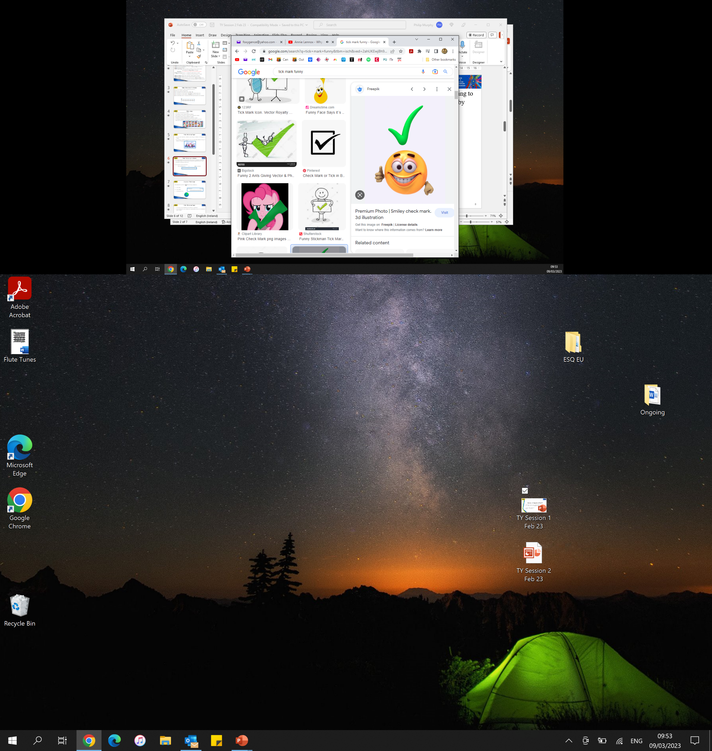
Instructions for Students
People have different opinions about how they relate to a community. I am going to ask you about three communities. For each one, indicate how attached you feel to it by ticking the point on the scale which reflects you.
The response scale for each item is;
1 Not Attached At All..……….to……………10 Very Attached

Slide 4
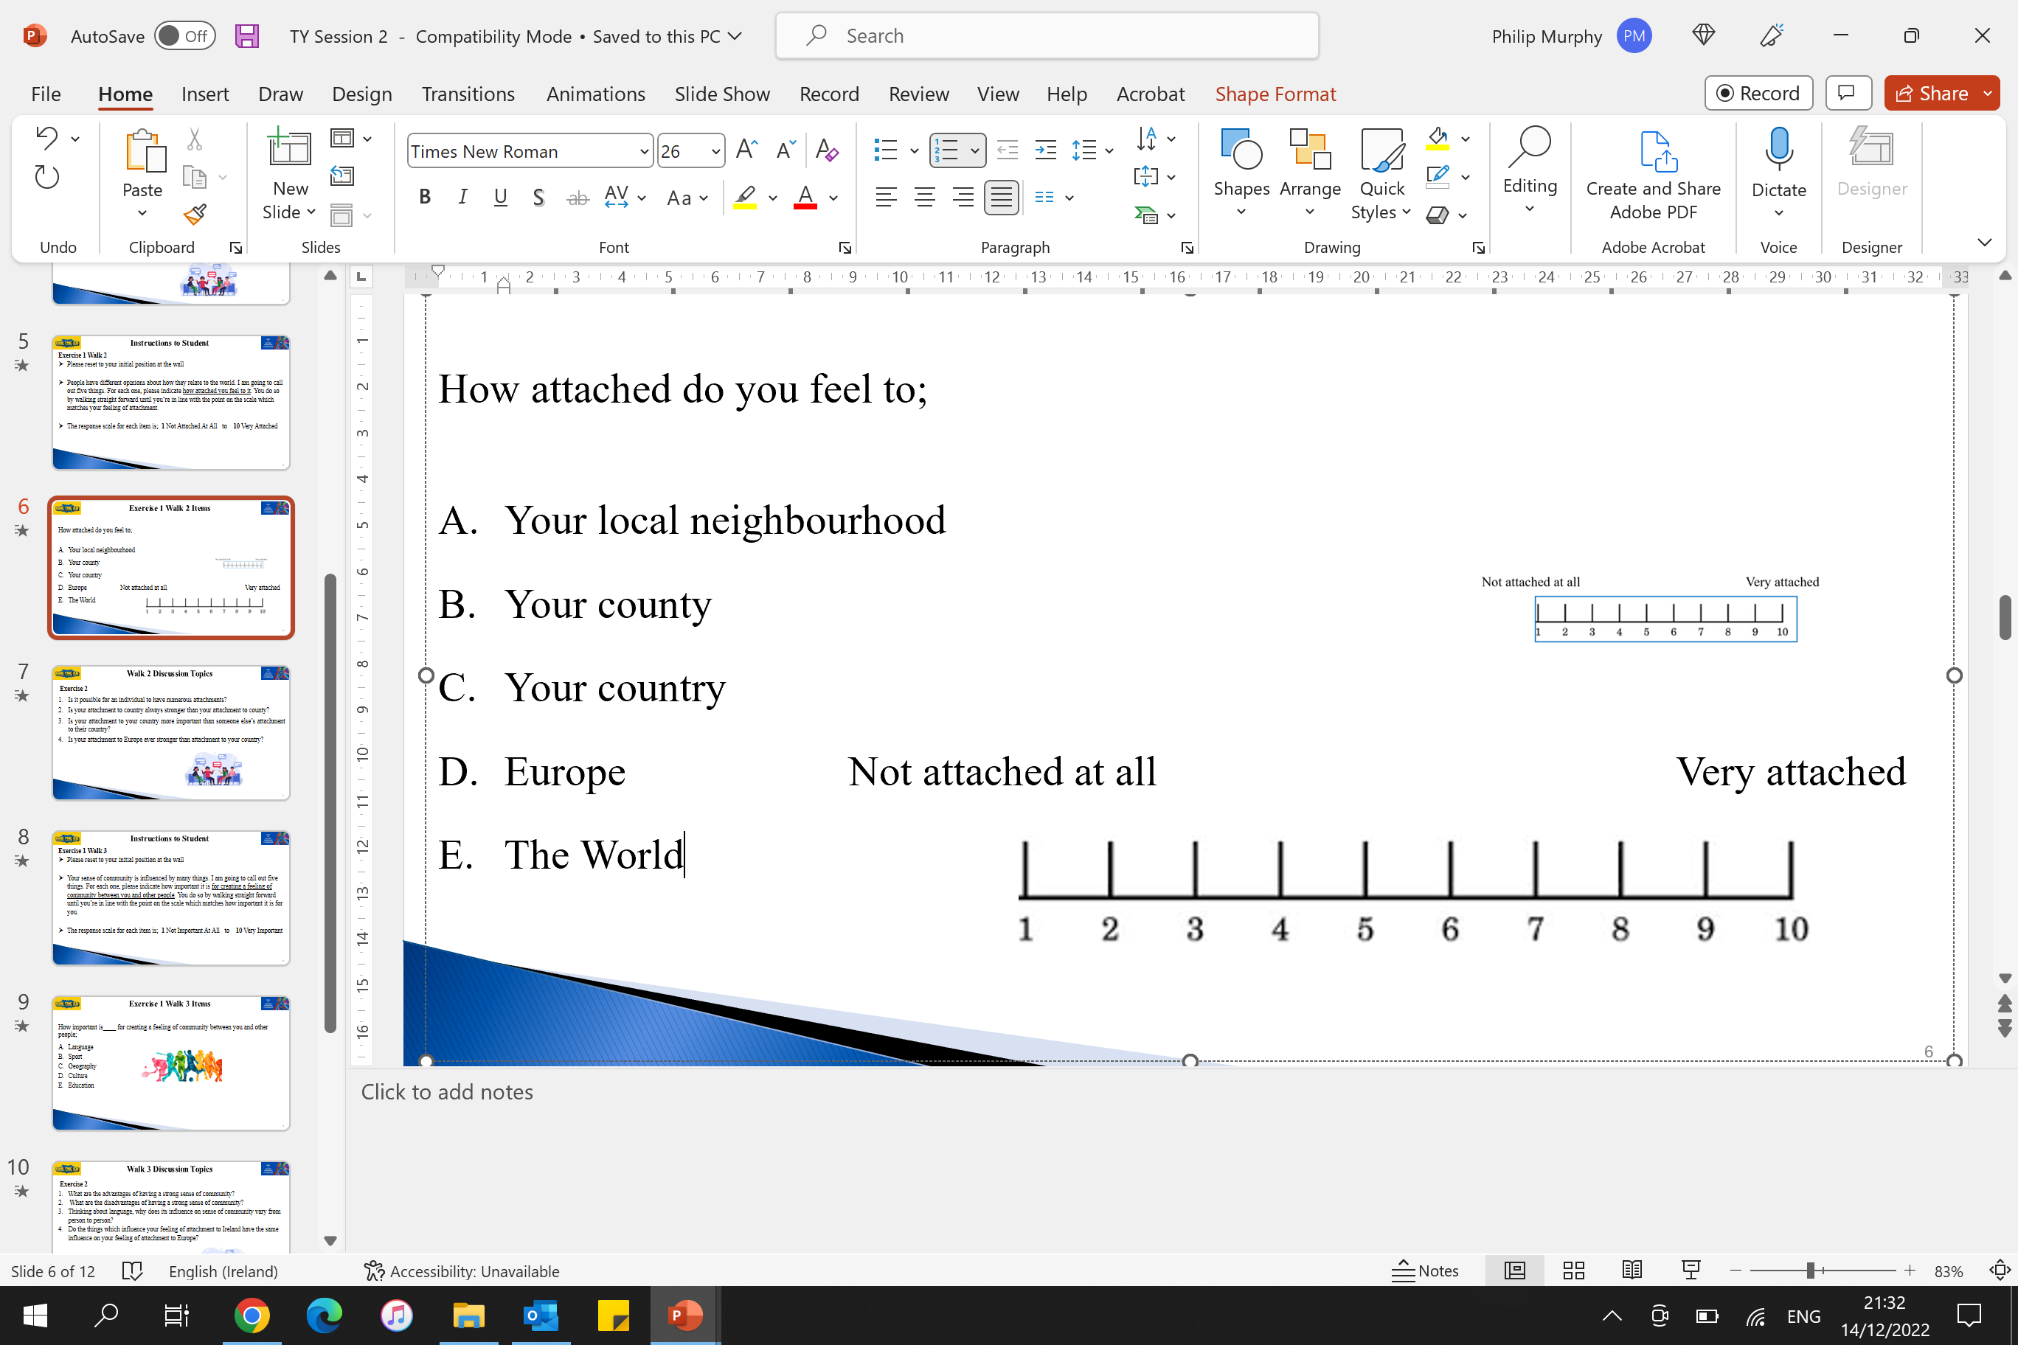
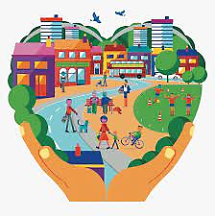
Questions
How attached do you feel to each of the following communities;
Your county
Your country
The European Union

Slide 5

Discussion Topics
Is it possible to feel attached to more than one community?
Is your attachment to your country more important than someone else’s attachment to their country?

Slide 6
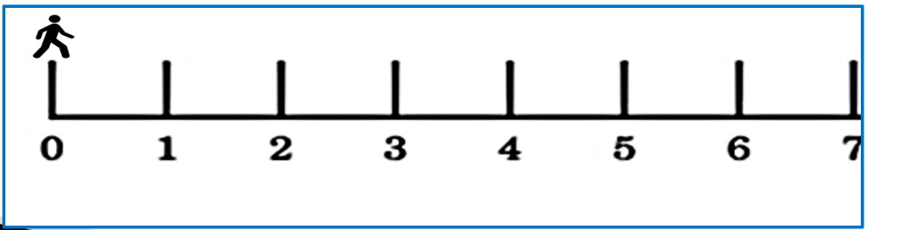
Instructions for Students
Now, I am going to ask you 7 questions about your experiences
There are no right or wrong answers
For each question, the response option is Yes or No
For each question, if your response is Yes move one number up the scale
For each question, if your response is No hold your position on the scale
It’s an individual exercise. Let your position reflect your experience, not your classmates

Slide 7
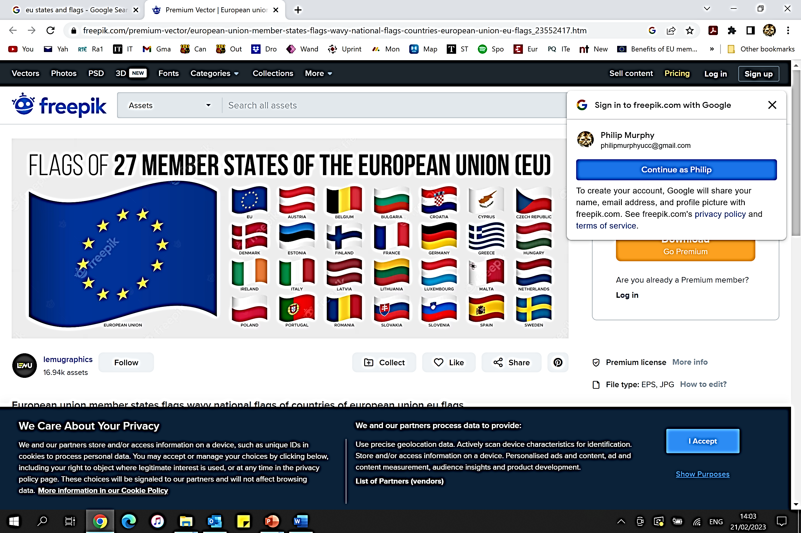
Questions On EU Experience
Have you visited another EU country?
Do you know a song in another European language?
Have you been to a sporting or cultural event in another EU country?
Do you have relatives living in another EU country?
Was any of your parents/guardians born in another EU country?
Are European languages (other than English or Irish) spoken in your home?
Have you lived for at least a few months in another EU country?

Slide 8

Discussion Topics
How do your experiences influence your feeling of attachment to a community?
Does hearing of different experiences help you understand other people’s different sense of attachment or identity?

Slide 9
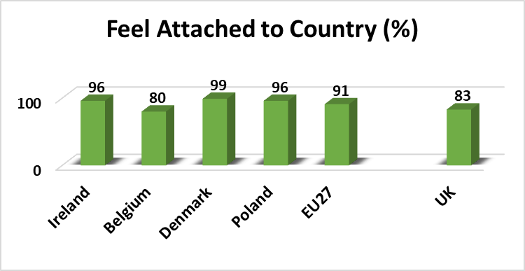
Something To Think About
  In a 2022 survey, a random sample of adults were asked; “Please tell me how attached you feel to your country”. This chart shows the percentage who responded with ‘very attached’ or ‘fairly attached’.
  The survey (Eurobarometer) had over
  1,000 respondents in each country
  EU27 is the average across
  EU member countries
  Does the difference in feeling of attachment across country surprise you?
  Can you think of things relating to community and identity in the UK or Belgium to explain the lower attachment to country there?

Slide 10
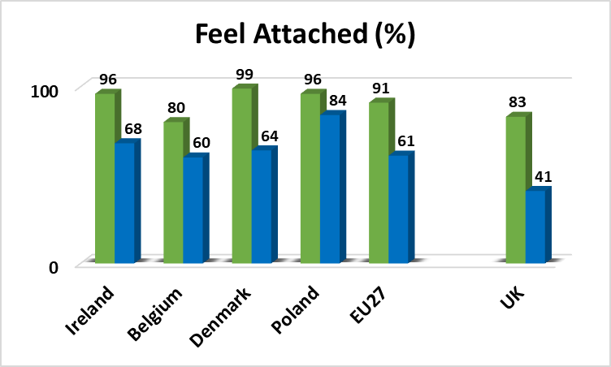
Something To Think About
  Respondents were also asked; “Please tell me how attached you feel to the European Union”. This chart shows the percentage who responded with ‘very attached’ or ‘fairly attached’ to country, and to the EU.
  Attachment to country
  Attachment to the EU
  What do you think about the difference in attachment to country and attachment to the EU in Ireland, and in other countries?
  The United Kingdom left the EU in 2020. What do you think about the percentage of people in the UK who still feel attached to the EU in 2022?

Slide 11
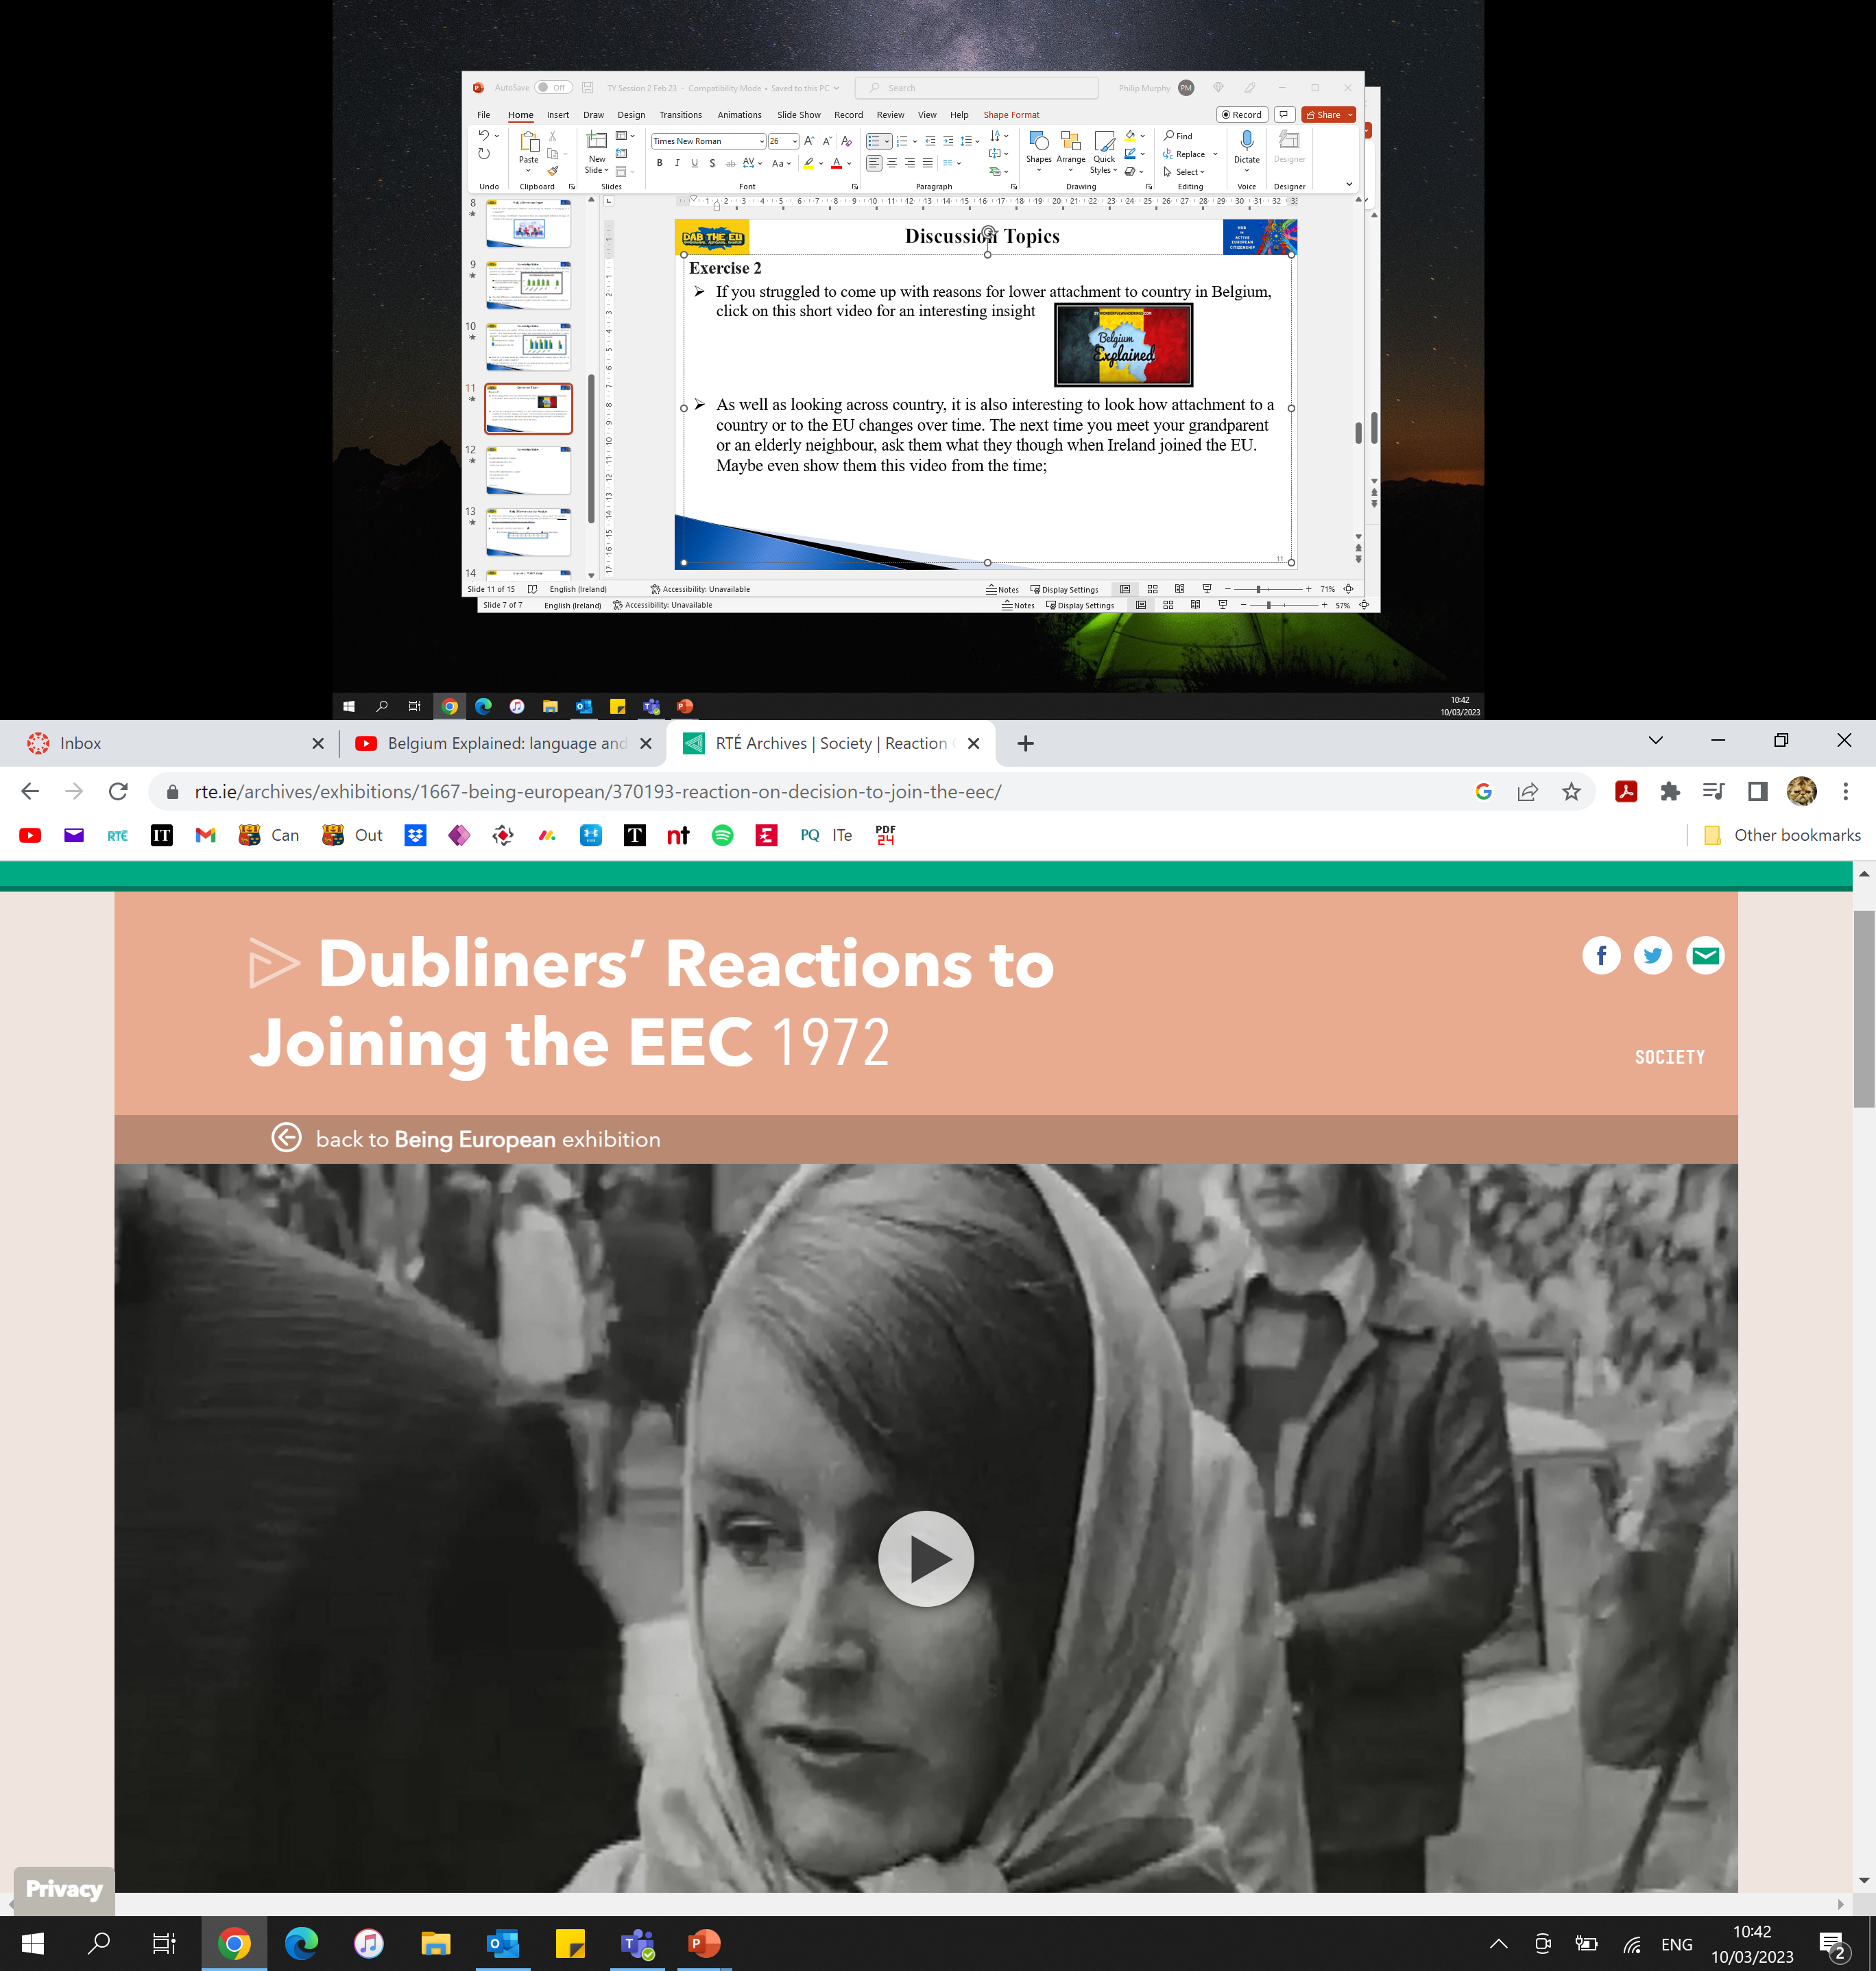
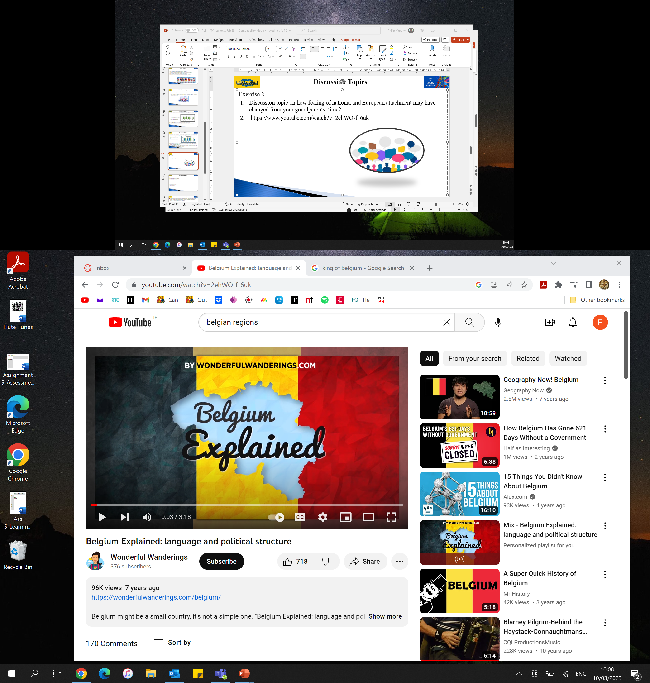

Reflection Time
  Attachment to country and to the EU also changes over time. When you meet your grandparent(s), ask what they thought of their country joining the EU when it did? This RTÉ Archive clip offers an Irish snapshot:
  If you came up with reasons for the lower attachment to country in Belgium, compare them with the insights in this clip:
  As a final reflection; what things increase your sense of belonging to Ireland? Is it the same for the EU? Are they the same as your classmates?

