Slide 1





Topic 1
Why was the European Union
created?
*WWII
*Cooperation
*Key concept- Shared sovereignty
*Membership
History- Strand 2 - LO 2.13 - 30 minutes

Slide 2


Get in groups of 6 students
You have 3 minutes to list all 27 EU countries

Slide 3


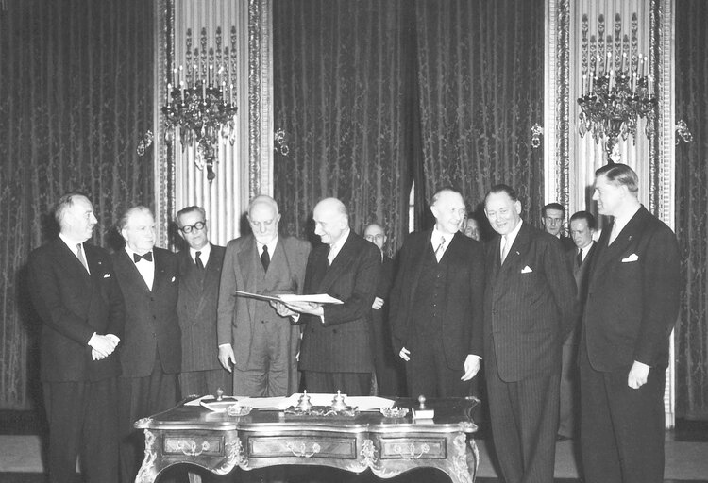
How it started
It is a unique economic and political union built for peace after WWII
The starting idea:
If countries share the control they have over key material, they will be less likely to go to war.
6 countries created the
European Coal and Steel Community (ECSC) in 1951 - coal & steel were essential to make weaponry.
Signature Treaty of Paris which sets up ECSC

Slide 4




Remember
The European Union is based on shared sovereignty.
Sovereignty = the authority/power a state has to make its own rules.
The EU is a club where all countries joining share their sovereignty with other members AND European institutions. They make decisions together which apply to all in some agreed areas, e.g. the environment or food safety. They have to compromise a lot to find an agreement.
We are all interdependent in this club.
Sovereignty = independent power

Slide 5


The European Community for Coal and Steel was created in 1950 by 6 countries:
France, Germany, Italy, Belgium, Netherlands, Luxembourg.
The same 6 decided to extend the experiment to other areas such as agriculture and trade. They created the European Economic Community in 1957 with the Treaty of Rome.
The name European Union was only adopted with the Maastricht Treaty in 1993. This treaty created the Euro and the
Economic Monetary Union (EMU)
In detail

Slide 6
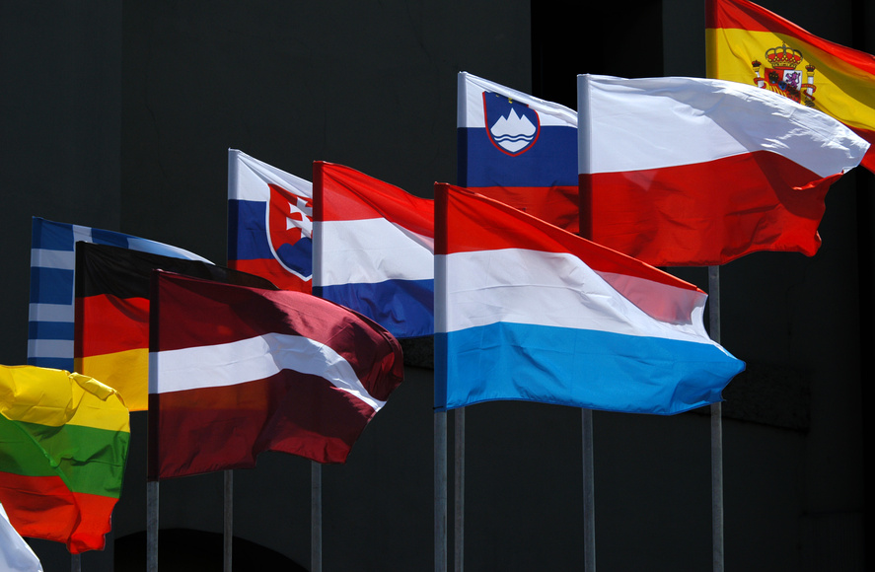


How it's going
From the initial 6, the EU grew on 7 occasions. It is now a club of 27 countries.
Ireland joined in 1973 together with the UK and Denmark.
Find out who they are on the next slide.
Biggest enlargement in 2004 to
10 countries of Central and Eastern Europe.
In 2016, the United Kingdom voted by referendum to leave the EU. It formally left on
31 January 2020

Slide 7
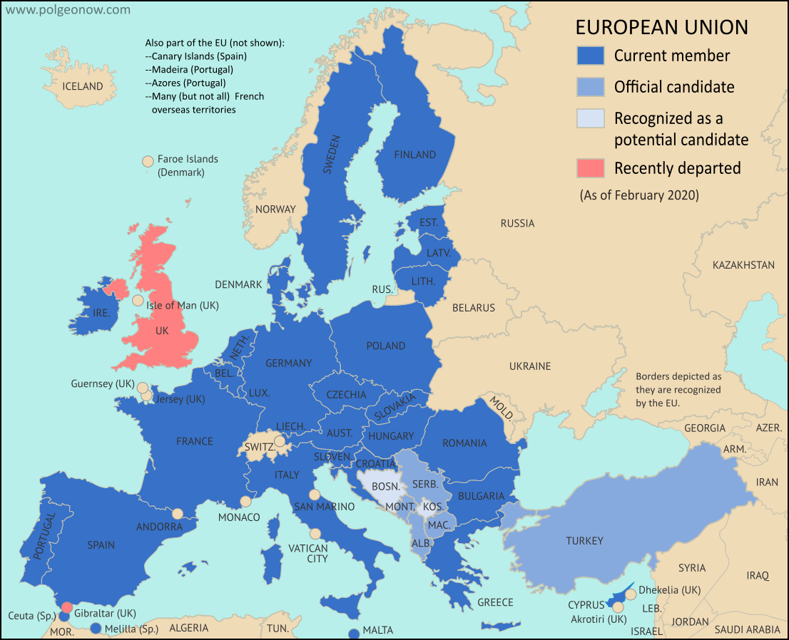
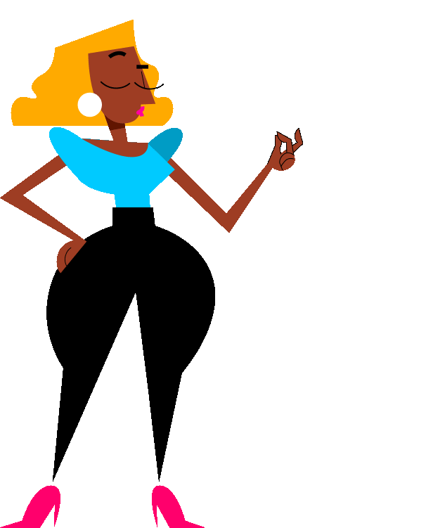

Ukraine and Georgia were given candidate status in 2022
WHAT IT LOOKS LIKE

Slide 8
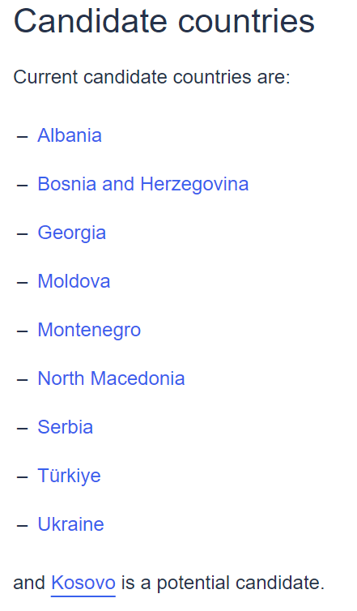

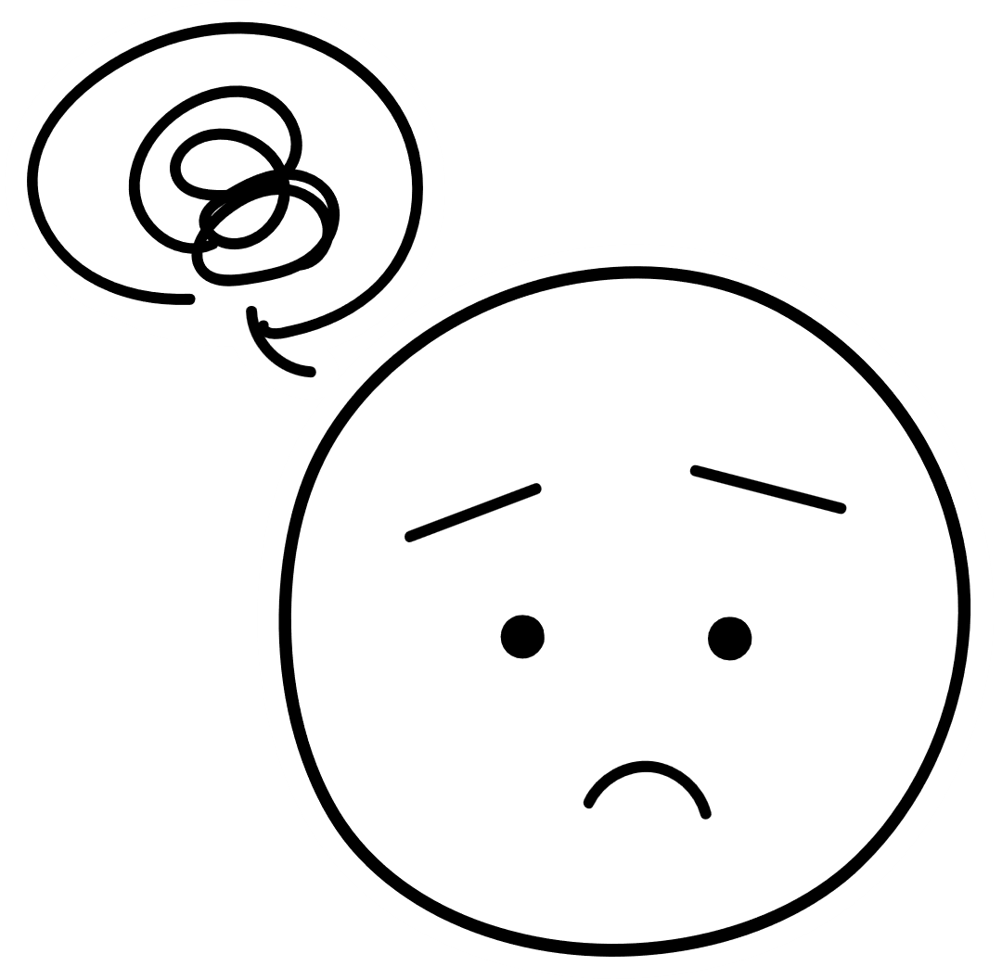
More countries to join... 9 official candidates
There are several stages before a country joins the EU.
It can take a very long time.
Ultimately all the existing members and the candidate country need to vote in favour for the enlargement to happen.

Slide 9






If you're curious, contact us, follow us
Hub in Active European Citizenship
@dab.the.eu
@dabtheeu
@HubEuropCitizen

