Slide 1





Topic 2
50 years of Ireland in the EU
*Membership
*Advantages and disadvantages
*Influence
*Europeanness
History- Strand 2 - LO 2.13 - 40 minutes

Slide 2
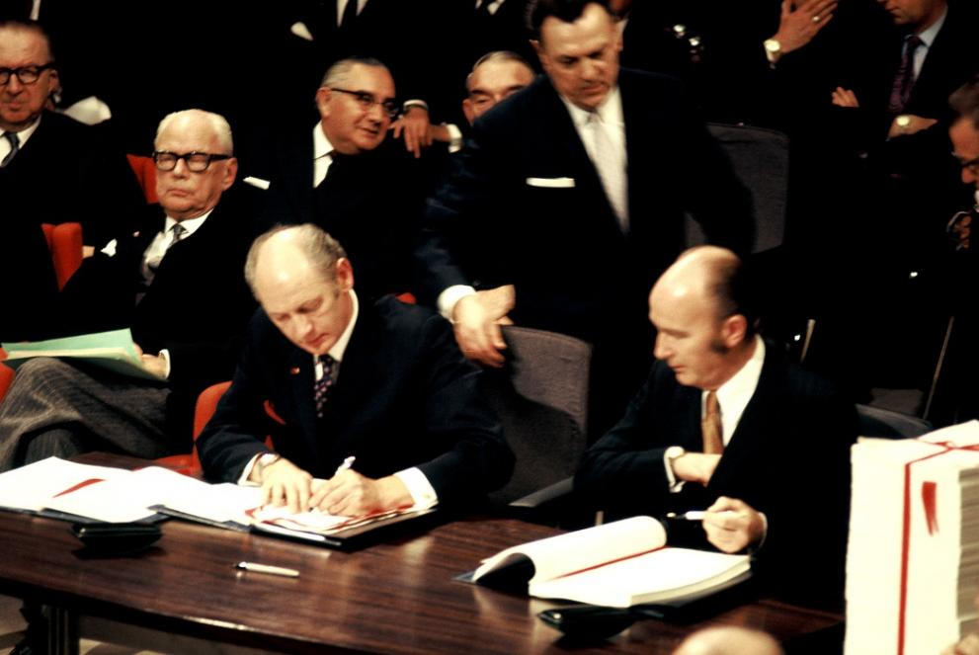
Ireland joined the EU in 1973
On 1 January 1973, Ireland officially joined a new community: the European Communities (EC). It was only in 1992, that the EC became the European Union (EU) with the signing of the Maastricht Treaty.
In a May 1972 referendum, the Irish electorate delivered a clear message: they wanted to be integrated into Europe; voting 83% in favour of entry.
The signing ceremony of the Accession Treaty for Ireland was held on 22 January 1972 in the Egmont Palace of Brussels. In the photo, Patrick Hillery, former Irish Minister for Foreign Affairs, and former Taoiseach Jack Lynch sign the Treaty.

Slide 3

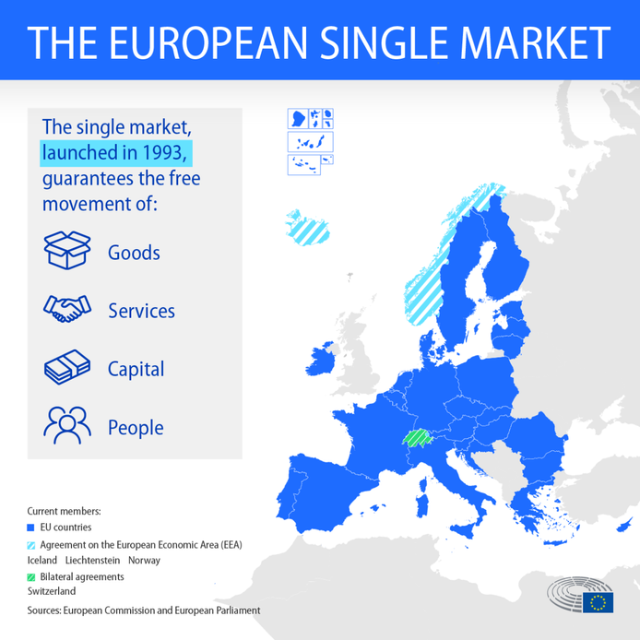
Benefits of EU membership to Ireland
ECONOMIC BENEFITS
The aims of the Irish government were to promote the immediate benefits of membership to the agricultural community through the promise of increased prices via the Common Agricultural Policy (CAP), and the longer-term benefit of access to European markets for industrial growth and increasing employment.
The benefit of Irish membership of the ‘Single Market’ is now estimated to be in excess of €30 billion annually. The EU sits alongside the United States and China as one of the world's largest economies.

Slide 4

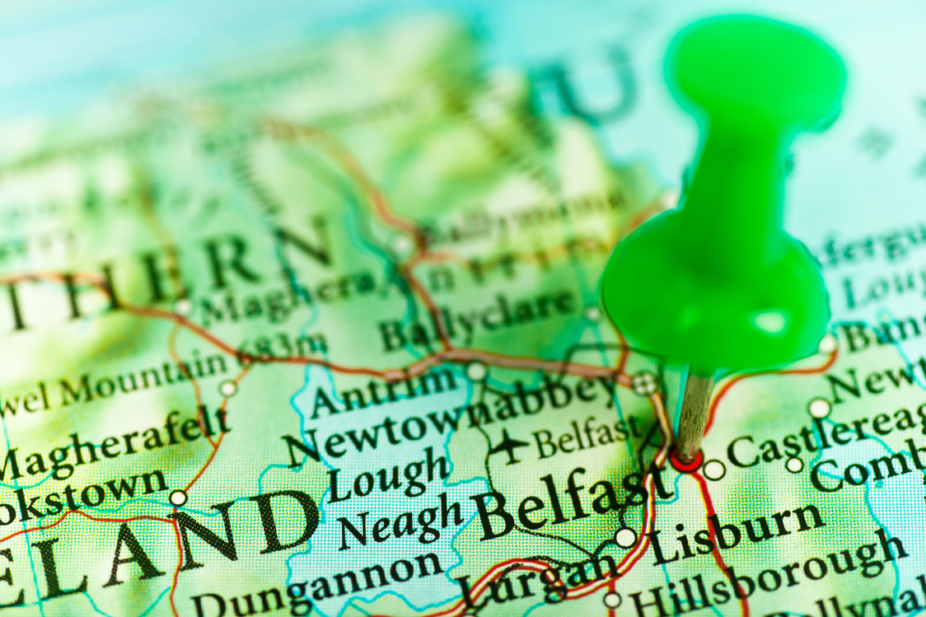

Benefits of EU membership to Ireland
POLITICAL BENEFITS
Just eight days after Ireland signed the Treaty of Accession to the European Communities ‘Bloody Sunday’ ensured that news of violence on the island of Ireland made headlines globally.
Throughout tumultuous times, the European Parliament often provided a neutral political platform for Northern Ireland nationalists and unionists to meet.
In 1998, the milestone peace agreement, the Good Friday Agreement, was signed and changed life in Northern Ireland. The EU has always fully supported the Irish peace process through initiatives such as the PEACE funding programmes and by promoting economic and social engagements.

Slide 5
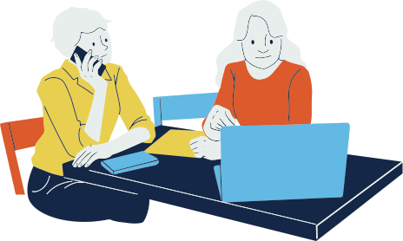
Benefits of EU membership to Ireland
SOCIAL BENEFITS
In 1973 Irish women were discriminated against significantly in the workplace. It was accepted practice that men were paid more for undertaking the same task. ‘Equal pay for equal work’ came slowly to 1970s Ireland. There was also a marriage bar in place whereby women in public service jobs had to resign upon marriage; a restriction which was removed as a direct consequence of EEC membership.
When Ireland joined the EEC there were only 287,800 Irish women in employment, representing 27% of the total workforce. By 2018 there were more than 804,700 women in the labour market, a participation rate of 77.2% of the female population.

Slide 6
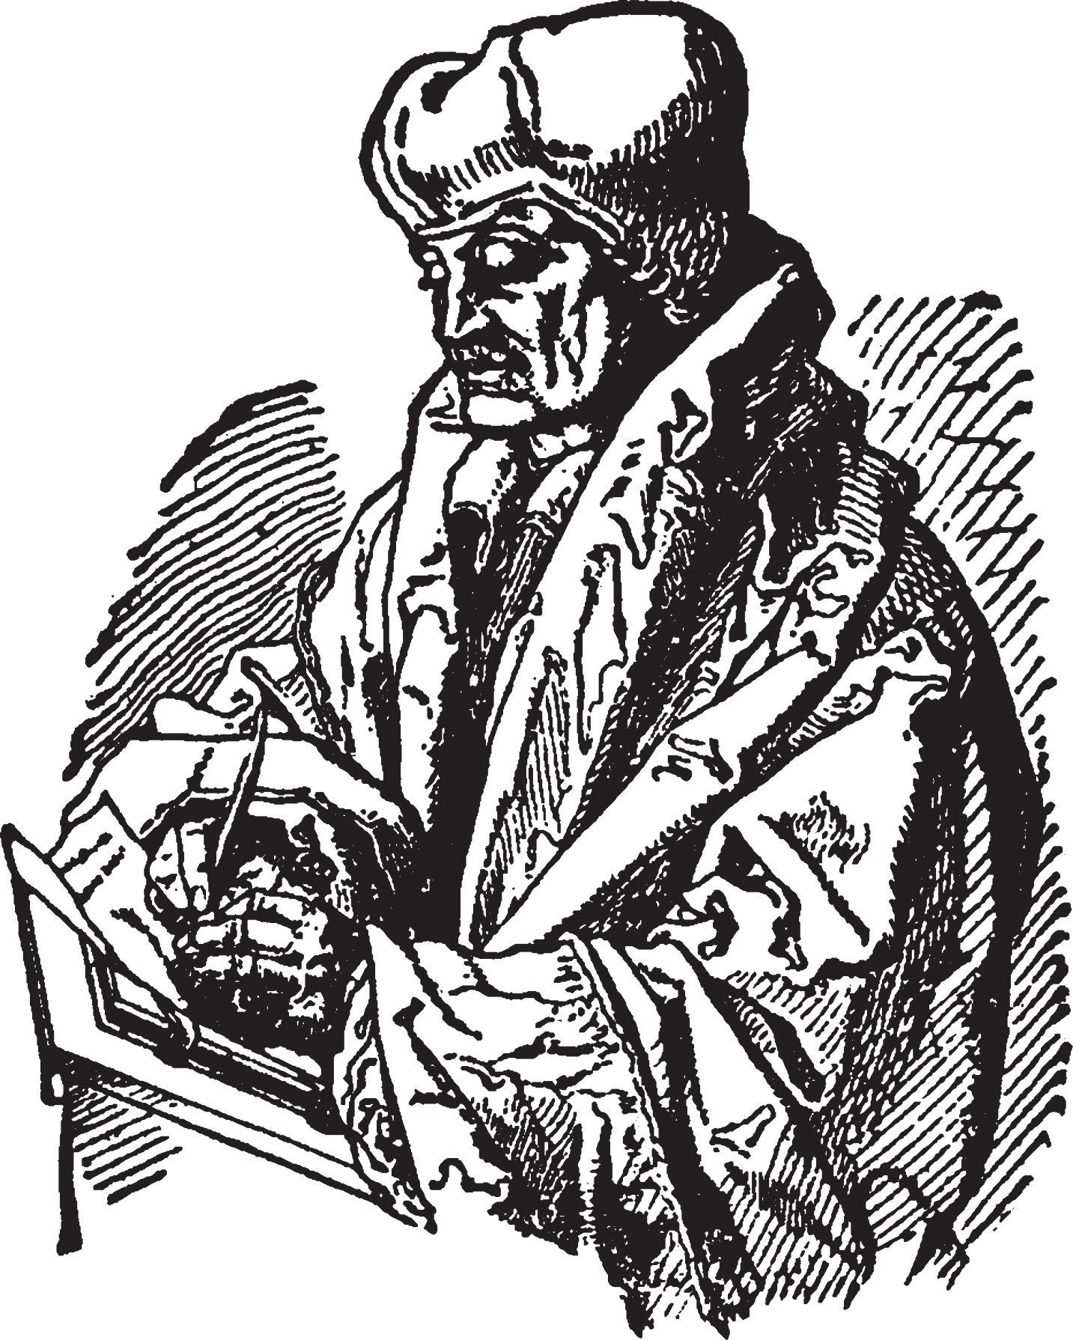
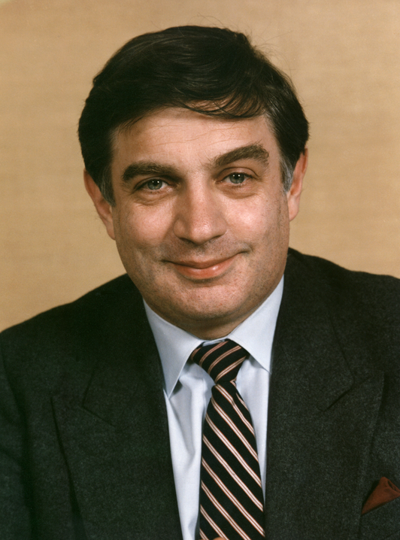
Benefits of EU membership to Ireland
SOCIO-CULTURAL BENEFITS
Ireland has always been very linked to the rest of Europe through scholarly work and travelling.
There are Irish Colleges in Italy, Spain and Belgium.
Irish students have also benefited from the European programme Erasmus, which allows college students and apprentices to spend a semester or a year in another EU country, in a similar setting.
Peter Sutherland, one of Ireland’s EU Commissioners, was considered by many to have been the ‘Father of Erasmus’.

Slide 7



Where are we now?
Ireland has remained quite Anglo-American in its cultural and socio-economic development, extremely reliant on the English-speaking world - media, music, travelling.
Furthermore, Irish students’ participation in the Erasmus programme has traditionally been among the lowest in the EU, largely due to a lack of linguistic skills.

Slide 8

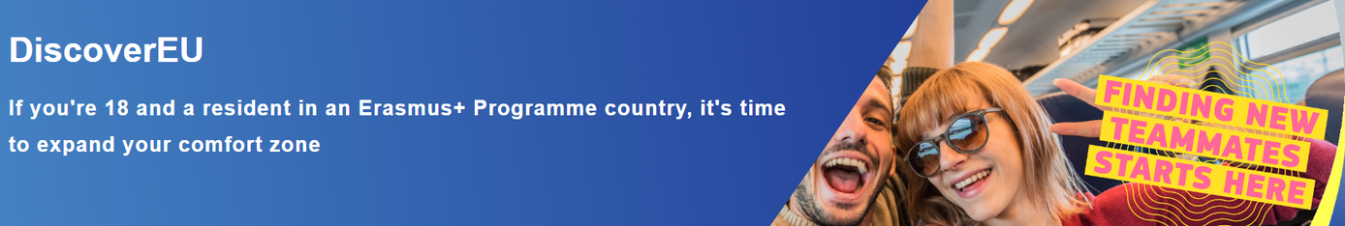
Where are we now?
Overall, Irish students are still more tempted to get a J1 visa or take a gap year in Australia or New Zealand than to go for an internship in Warsaw or Madrid.
Think free inter-railing tickets thoughout the Europe thanks to the EU!
This is becoming a significant challenge for Ireland in terms of future influence at European level.

Slide 9


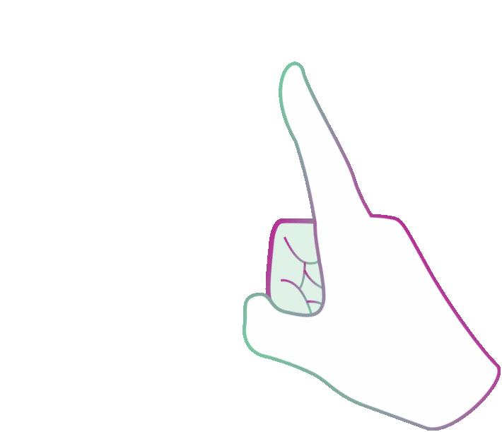
Don’t forget to play our chatbot game on the home page of DABtheEU, right bottom corner, to test your knowledge on 50 years of Ireland in the EU!
Good luck.

Slide 10

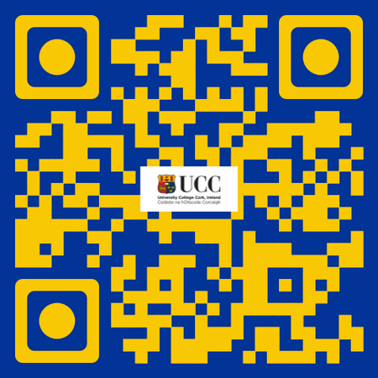




If you're curious, contact us, follow us
Hub in Active European Citizenship
@dab.the.eu
@dabtheeu
@HubEuropCitizen

