Slide 1





Topic 9
Democracy,
member states and the EU
*Multilevel
*Accountability
*Citizens' involvement
CSPE - Strand 3 - LO 3.6 - 30 minutes

Slide 2


A reminder on the democratic deficit criticism
Looking at the democratic deficit in the EU, there are two main reasons why the European Union is criticised for its lack of democracy:
The European Commission is not directly elected by the European citizens
The European Parliament cannot introduce a piece of legislation (only the European Commission can). So the people we directly elect, the MEPs, cannot put forward a proposal for legislation.

Slide 3

How democratic are the member states?
The European Union is a multilevel political system with:
European institutions
National governments
Local governments
EU
National gov
The European Union political system works on a system of checks and balances between the national and the European level (see topic 7).
Local governments
Democracy

Slide 4
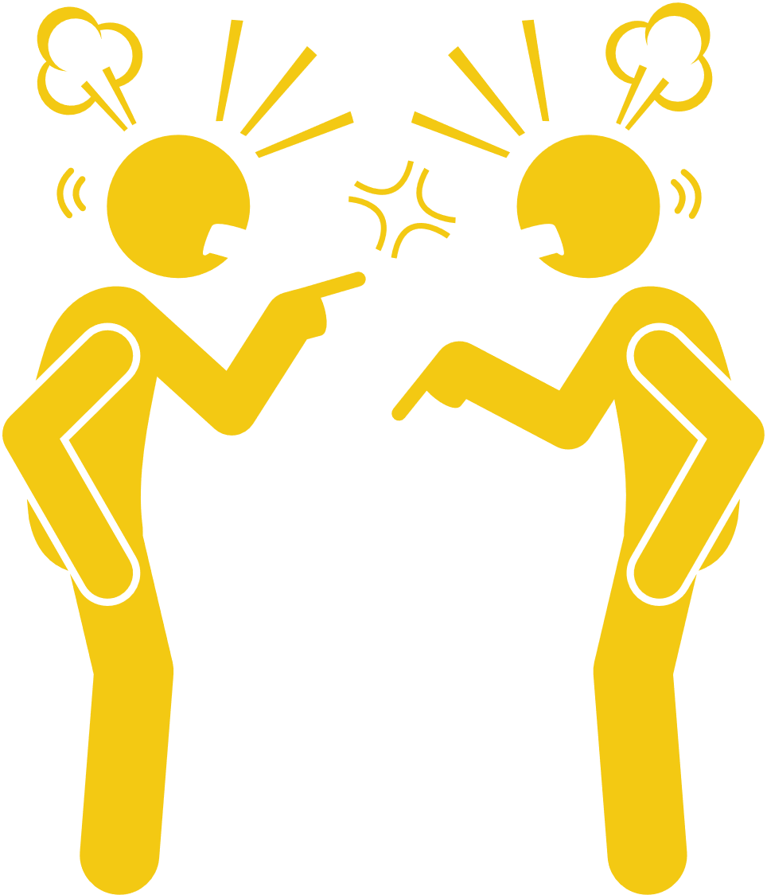


Democratic deficit or democratic backsliding?
The quality of democracy in EU countries is going backwards in many countries because of declining quality of deliberation.
How do we know if we have good deliberation? If we have the following:
reasoned justification,
references to the common good,
respect for counter-arguments,
range of consultation and engaged society .
This is most evident in Romania, Hungary, Poland, Bulgaria, Malta and Croatia. However, we can also see this tendency in countries like France.
Source in the Wakelet: Anna Gora & Pieter de Wilde (2020): The essence of democratic backsliding in the European Union: deliberation and rule of law, Journal of European Public Policy, DOI: 10.1080/13501763.2020.1855465

Slide 5

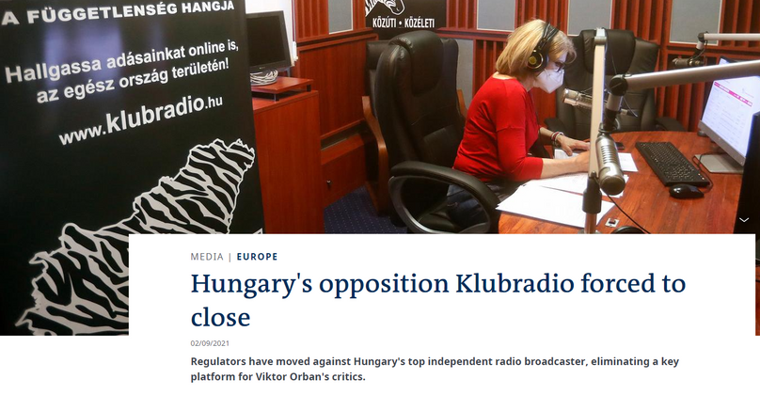

Undermining of EU values
At the heart of EU democracy, you have EU values such as
pluralism (respect of all legal opinions),
separation of powers (judges should be independent from the government),
rule of law (the law should apply to everybody the same way.
The Hungarian government under Orban and the Polish government under Morawiecki do not respect the independence of judges.
Read here
The Hungarian government closed down a radio station that was opposing the government.

Slide 6




Brainstorm
In groups of five, take 10 minutes to answer the questions below:
Do you think it is important for EU citizens to vote for the President of the European Commission? What would it change?
Should EU citizens be involved in suggesting new EU policies? How?
Through social and mainstream media, do you know enough about the EU and Ireland's role in it? Do you think this matters for EU democracy? In what ways?
If you feel brave enough, put your answer in a social media post on Insta or Tiktok tagging @dabtheeu

Slide 7






If you're curious, contact us, follow us
Hub in Active European Citizenship
@dab.the.eu
@dabtheeu
@HubEuropCitizen

