Slide 1


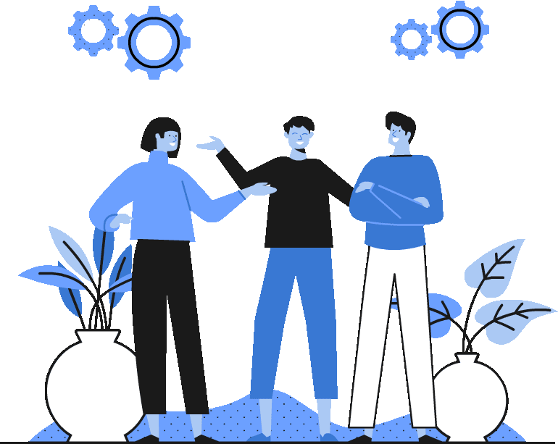

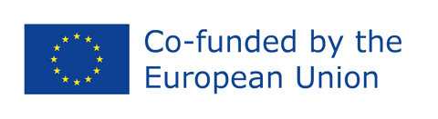
Topic 5
The EU and climate change
*European Green Deal
*Net zero
*Just Transition
CSPE - Strand 2 - LO 2.2, 2.4, 2.10 - 40 minutes

Slide 2

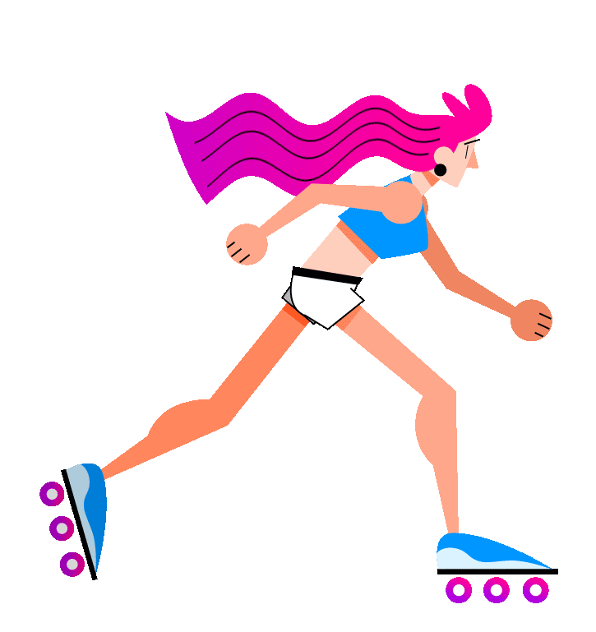
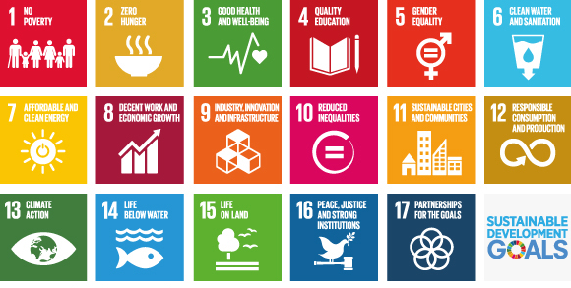
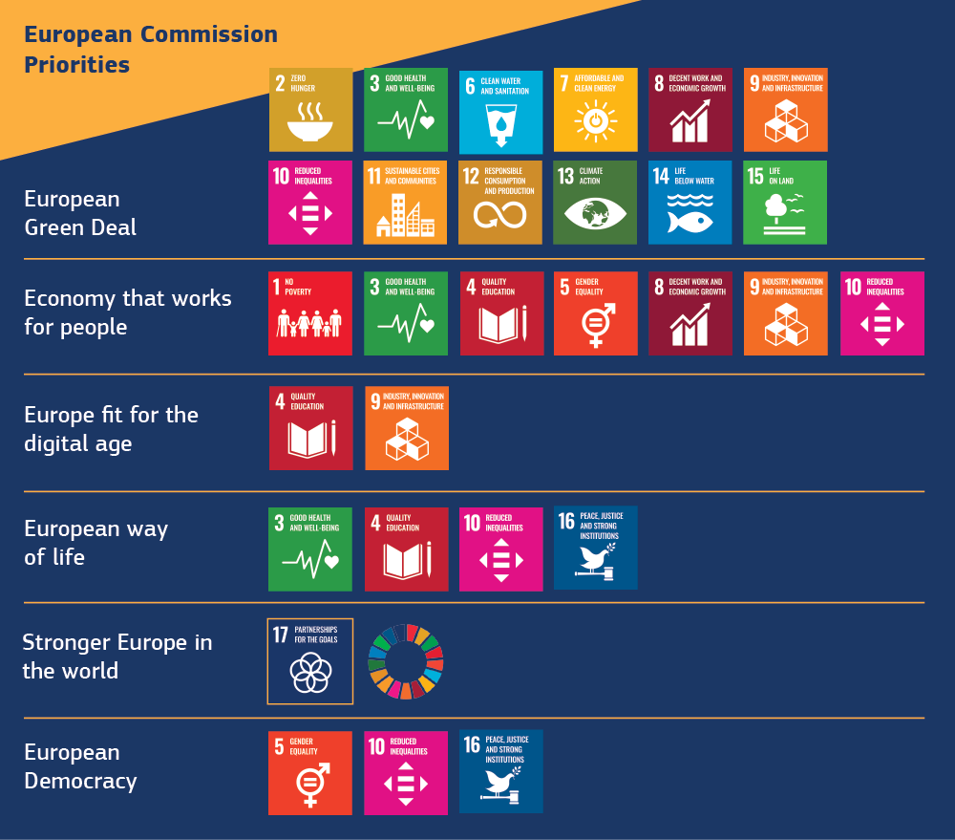
The EU and the SDGs
EU's priorities are mapped on the SDGs.
Same goals for global sustainability

Slide 3

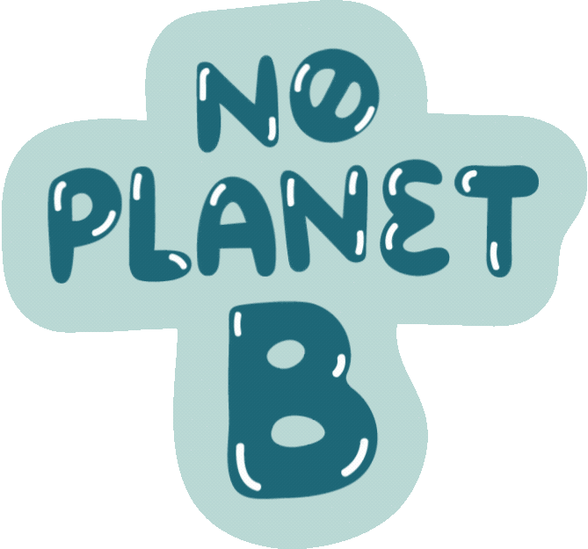
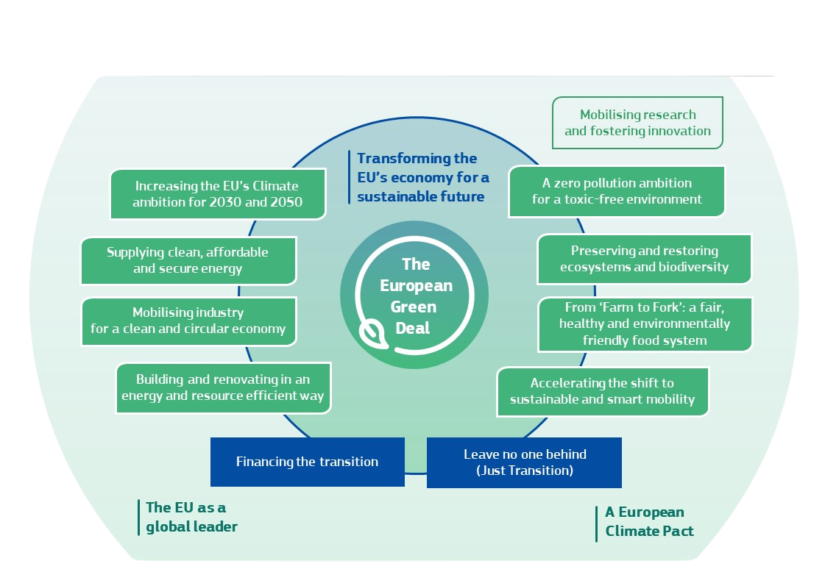

What is the European Green Deal?
This is the EU’s flagship climate change and environmental sustainability programme.
Introduced first in December 2019, it aims to radically change the European economy and society over the coming decades.
It is exceptionally wide-ranging in its scope: as well as covering energy, transport, buildings, and agriculture, it also captures themes such as trade, investment, and the EU’s relations with the rest of the world.

Slide 4



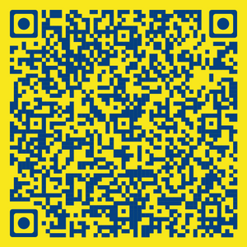

The EU's influence on climate change
The EU as first carbon neutral bloc by 2050
Cutting emissions by at least 55% by 2030

Slide 5


Remember key concept
NET ZERO
We need to remove greenhouse gases – the gases that cause climate change – from our economy as much and as soon as possible.
However, some sources of greenhouse gases are very difficult, if not impossible, to completely eliminate.
The idea of “net zero” is that we would balance any remaining emissions by removing emissions from the atmosphere.
Some ways of removing emissions are natural and well-known – such as the oceans and forests, which suck carbon dioxide out of the atmosphere. Other approaches involve technologies that have not yet been fully proven.
Some say it's a bad concept because it helps perpetuate a belief that technology will save us. It diminishes the sense of urgency surrounding the need to curb emissions now.
More info here

Slide 6

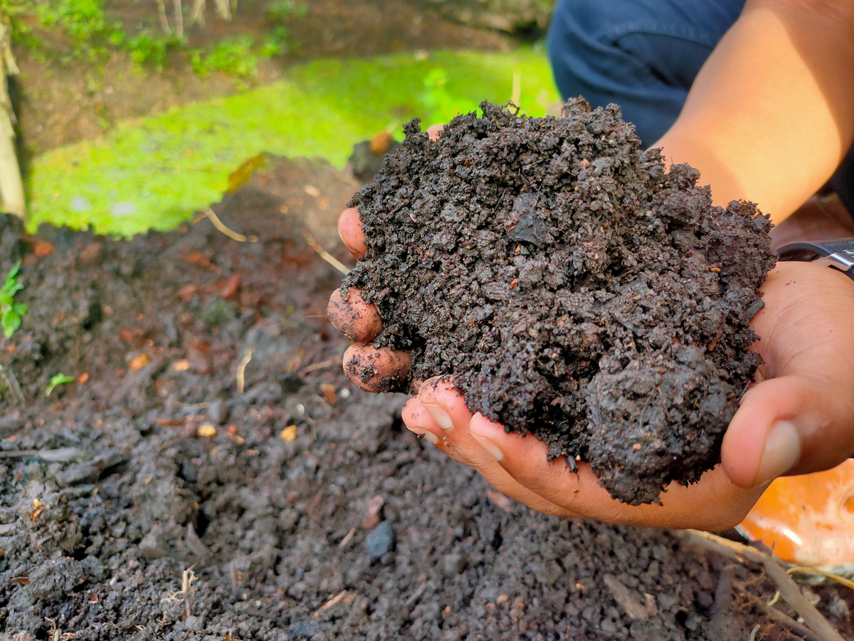


Just transition
This is the idea that, as we transition away from fossil fuels and other forms of pollution, we need to protect workers and communities whose lives and livelihoods are dependent on those industries and activities.
Here in Ireland, a prominent example is the extraction of peat from bogs, which is a highly damaging activity. A just transition approach says that we should protect those workers and communities that lose out from our move away from reliance on peat, through new jobs, retraining, early retirement schemes, and other supports.

Slide 7

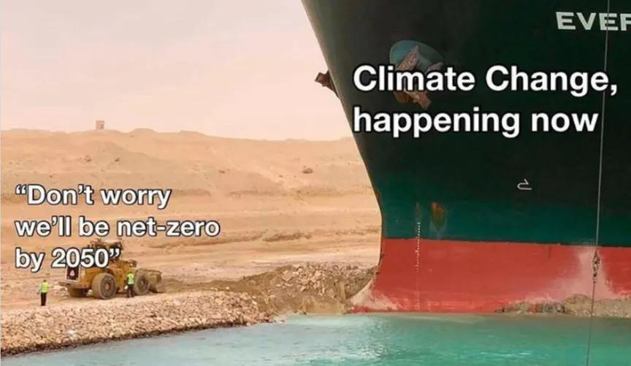
Your turn...
Analyse this meme
  What do you think the message is?
  Do you agree with the message?
  What would you add or take away to change this meme?

Slide 8

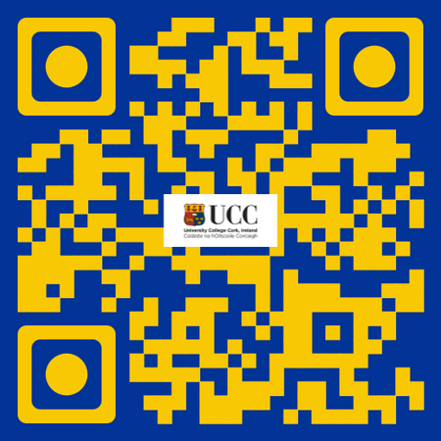




If you're curious, contact us, follow us
Hub in Active European Citizenship
@dab.the.eu
@dabtheeu
@HubEuropCitizen

