Slide 1





Topic 4
What does the
European Union do?
*What is it?
*What is it in charge of?
What influence does it have?
How does it relate to Ireland?
CSPE - Strand 2 - LO 2.8 - 30 minutes

Slide 2

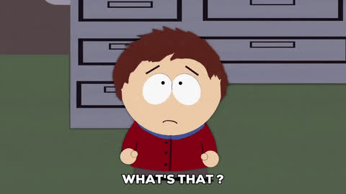

What is the European Union?
It is a club of 27 countries which are referred to as Member States
The EU has influence inside and outside the club through the rules it passes.
Any company, in or out of the EU, who wants to sell their good or service in the EU, needs to follow those rules.

Slide 3




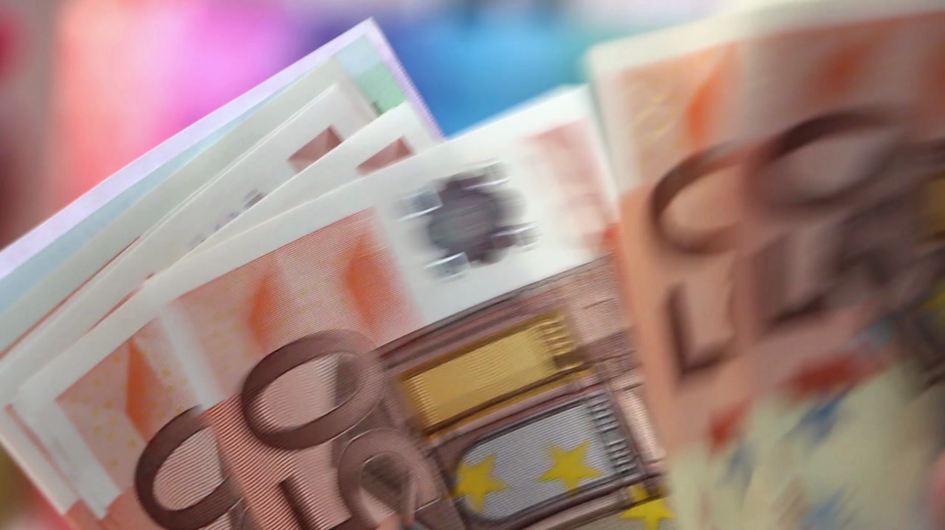

The EU is involved in...
Single Market
Common Agricultural Policy
Have you seen this sign before? Where?
Competition policy
Cohesion policy
Environmental policy
Trade policy
International Development
Justice and Home Affairs
Common Foreign and Security Policy
Economic and Monetary Union

Slide 4
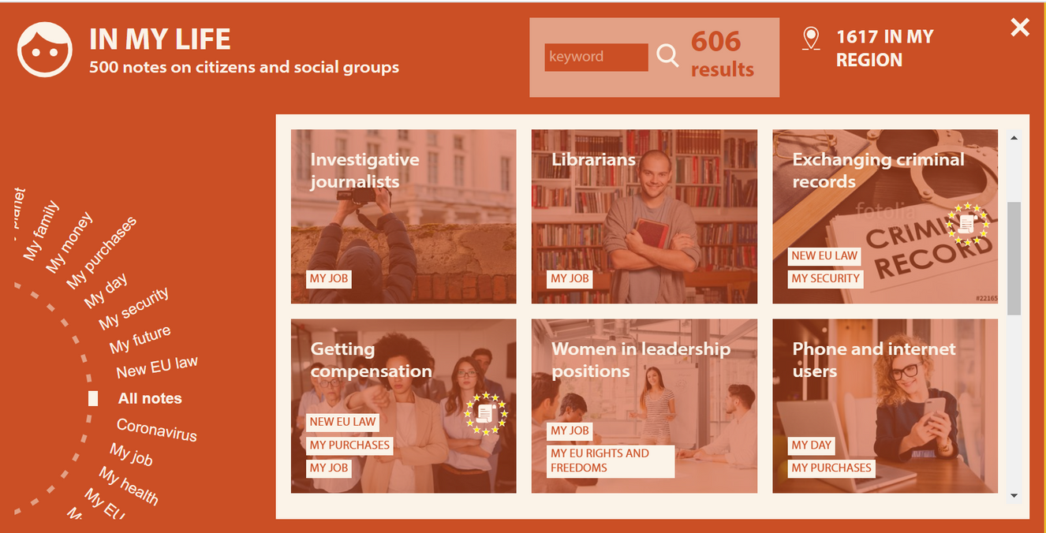


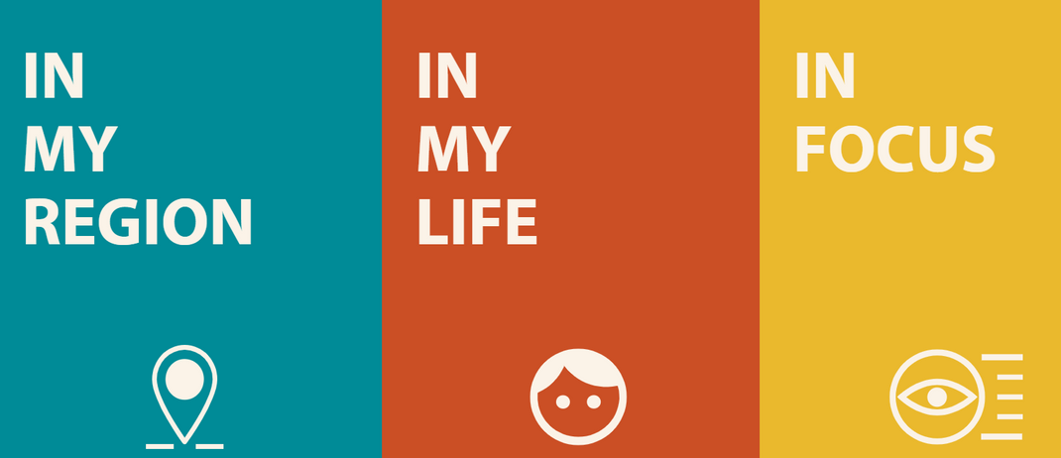
What does the EU do for me?
Great portal!!!

Slide 5






If you're curious, contact us, follow us
Hub in Active European Citizenship
@dab.the.eu
@dabtheeu
@HubEuropCitizen

