Slide 1


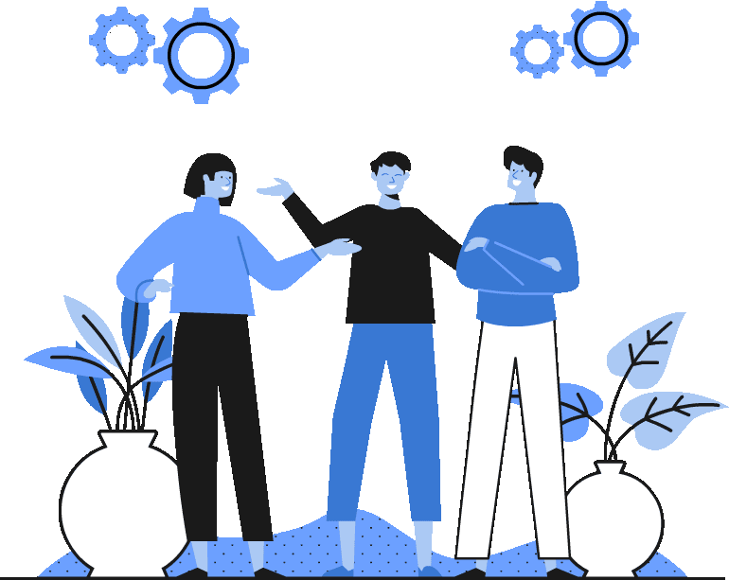


Topic 2
Connections and interdependence in the European Union
**Key concept- Shared sovereignty
*The EU and climate change
CSPE - Strand 2 - LO 2.1 - 20 minutes

Slide 2

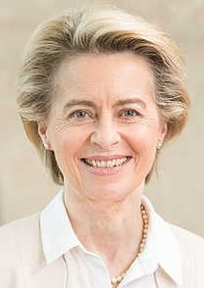

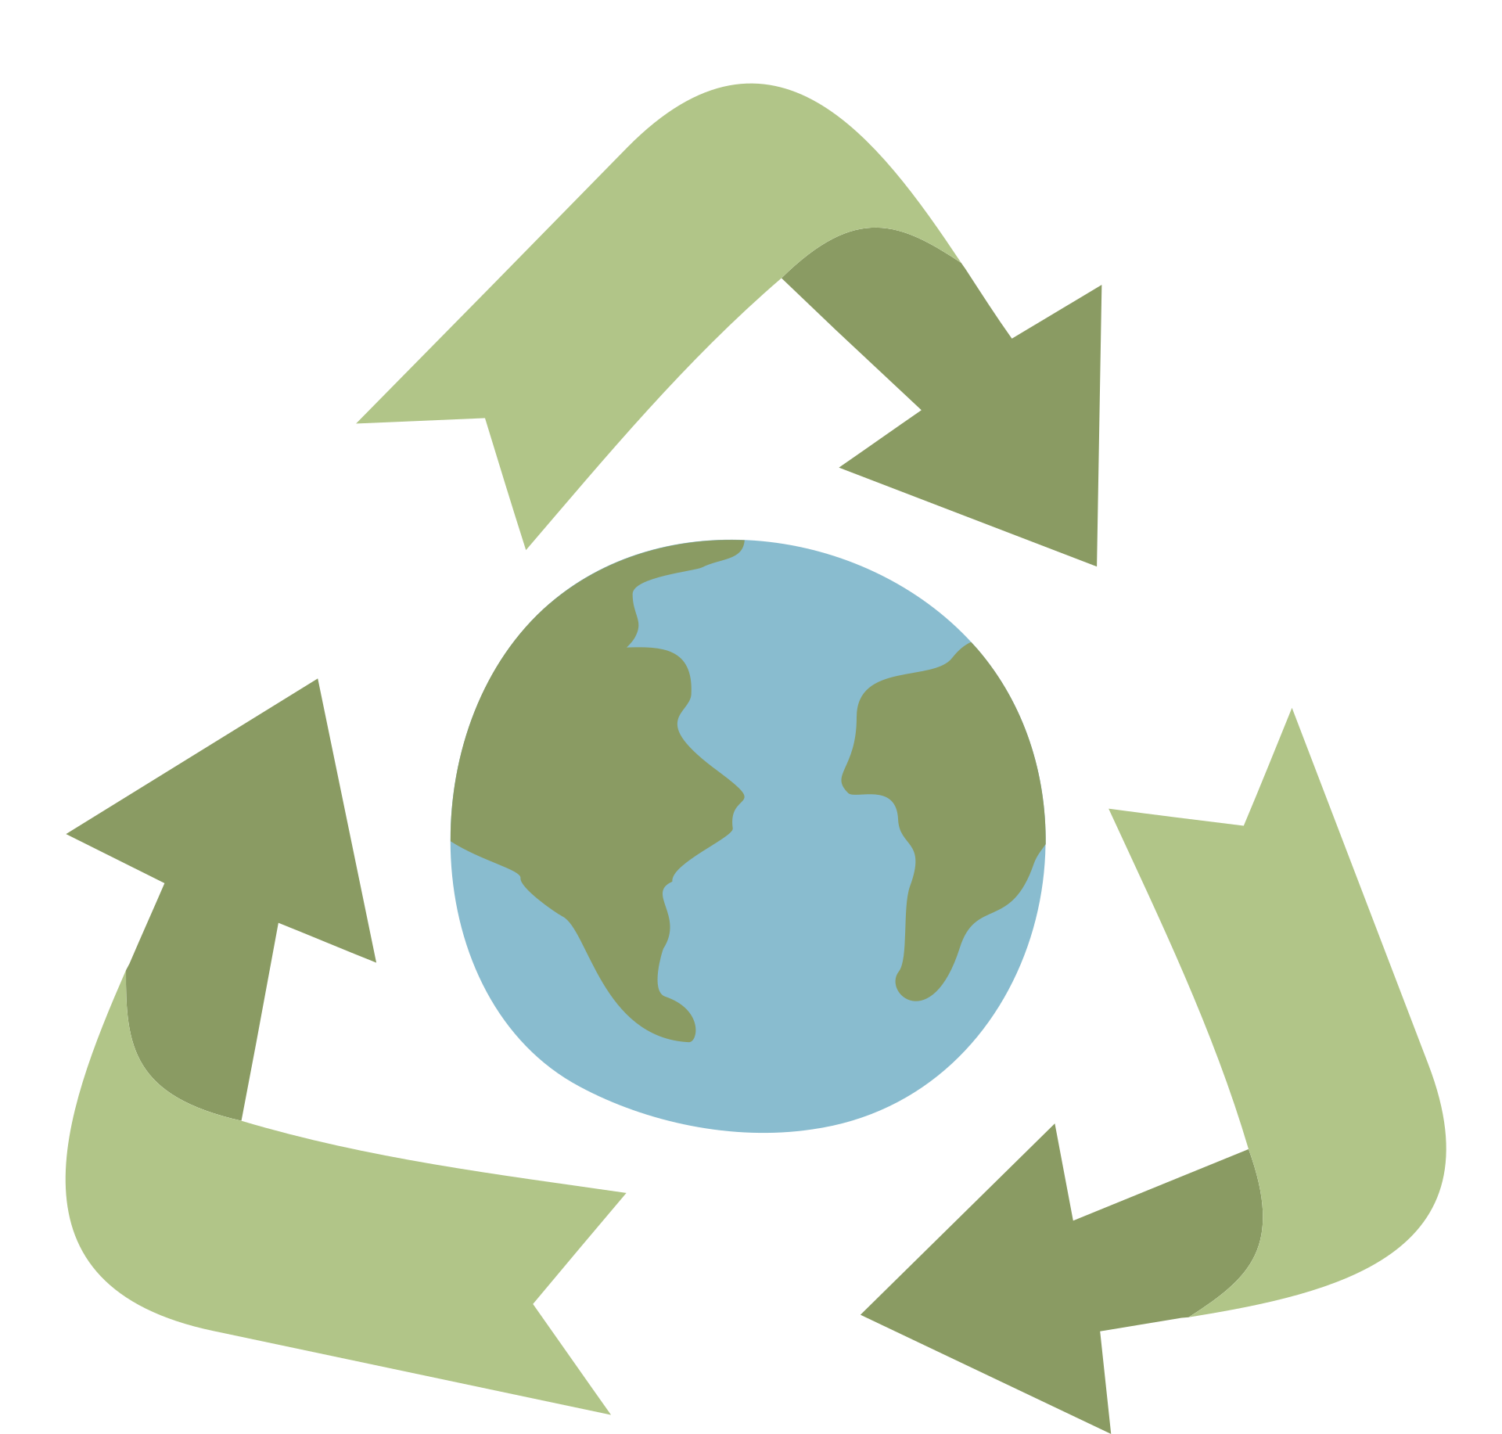
Priority of the 2019-2024 European Commission
The European Commission under the leadership of her President, Ursula von der Leyen, focused on making every aspects of our lives green.
It's called the European Green Deal.
Since the 27 member states share their sovereignty on environmental issues, we all have to make decisions together.
We are inter-connected and inter-dependent.

Slide 3



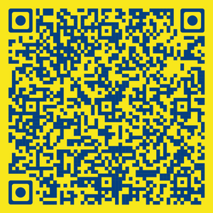

The EU's influence on climate change
The EU as first carbon neutral bloc by 2050
Cutting emissions by at least 55% by 2030

Slide 4




Walking debate
Is sharing sovereignty an effective way for a group of countries to make decisions?
Take the example of environmental policy.
"Can we share
sovereignty but all decisions require everyone to agree?"
"We are too small individually. We need to make decisions together to have an impact in the world."
"Shared sovereignty forces countries to do things that don't suit their needs. Ireland should look after itself by itself."

Slide 5

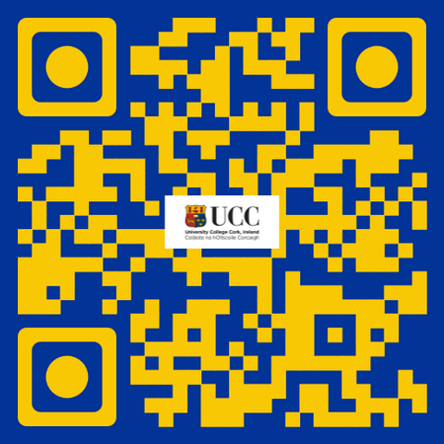




If you're curious, contact us, follow us
Hub in Active European Citizenship
@dab.the.eu
@dabtheeu
@HubEuropCitizen

