Slide 1





Topic 7
The EU's institutions
*Who are they?
*How do they work together?
*What do they do?
CSPE - Strand 3 - LO 3.4 - 40 minutes

Slide 2

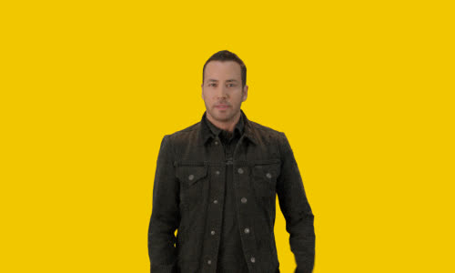

Click to find out

Slide 3
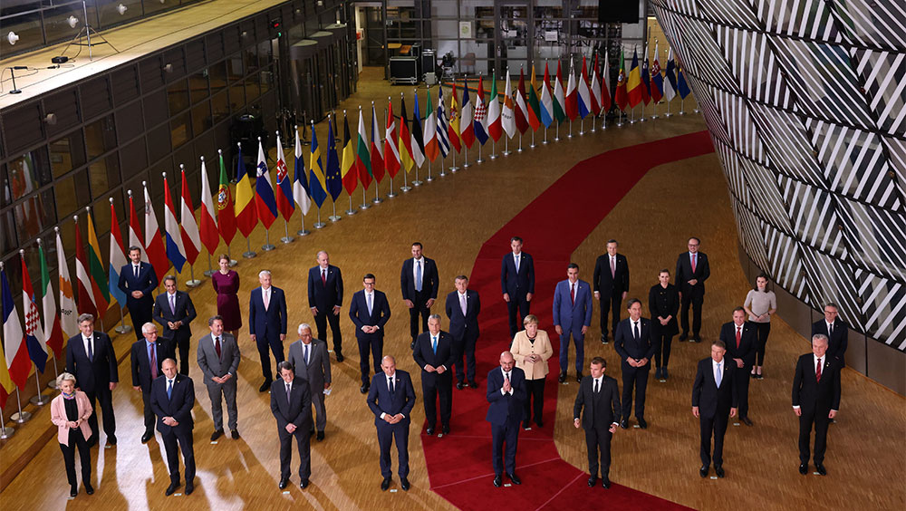
First institution - the European Council
When was it created?
This is the most recent institution, created in 1974
Who is in it?
The 27 Heads of State and Government -
Prime Ministers for most countries and Presidents for some, like France.

Slide 4
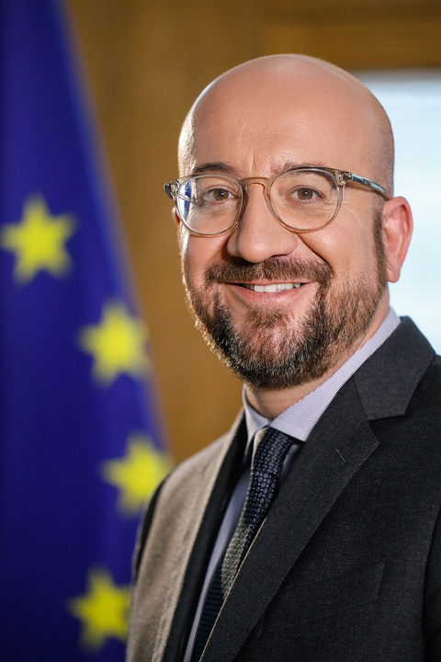
What does it do?
It focuses on giving the political impetus to the European Union, i.e. coming up with the big plans and ideas for the future of the EU
Who's in charge?
There is a European Council President, elected every 2 and a half years by the Heads of State and Government. His job is to get everyone to listen to each other and reach a compromise.
Charles Michel, President of the European Council 2019-2024

Slide 5
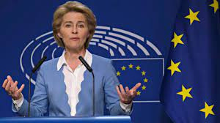
The European Commission
When was it created?
In 1958 with the Treaty of Rome
Ursula Von der Leyen
European Commission President 2019-2024
Who's in it?
27 Commissioners, including a President. It is one per country, voted in by the European Parliament, for 5 years, after a thorough interview. The President of the European Commission is interviewed and voted in separately

Slide 6

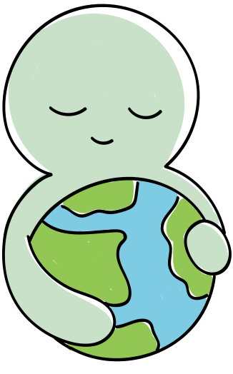

What does it do?
It is the only institution which can introduce a proposal for a new EU law in every area like food safety, environment protection, agriculture, etc.
EXCEPTIONS = Common and Foreign Security Policy and the Economic Monetary Union for example.
They do not represent their country but the general interest of the EU.
Who's in charge?
Each of the 27 Commissioners has a portfolio, i.e. an area of expertise like Agriculture or Economics.
There are about 33,000 officials who help them with all the technical details.

Slide 7
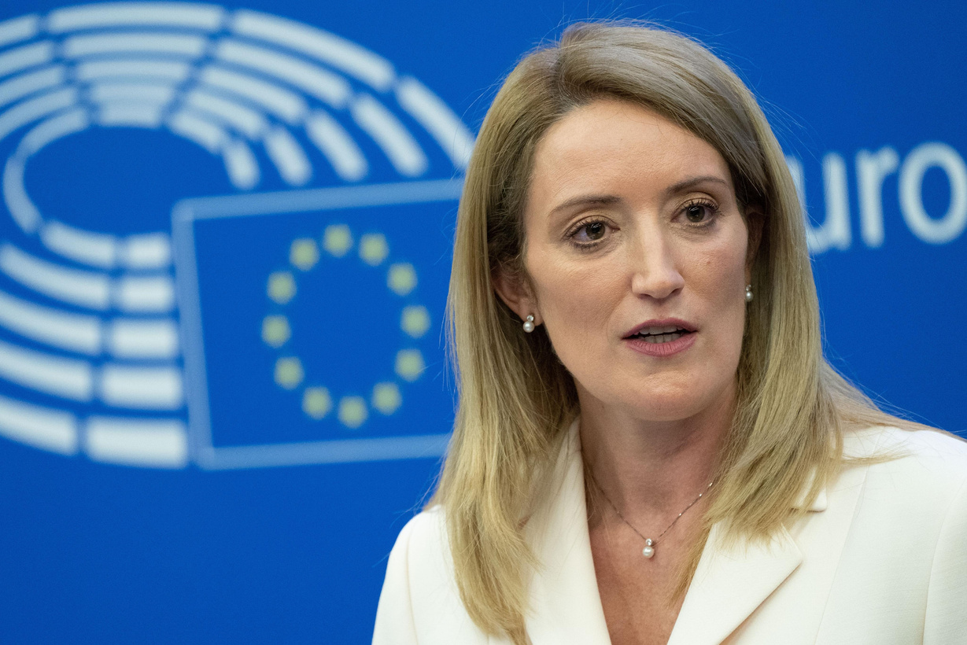
The European Parliament
When was it created?
In 1958 with the Treaty of Rome.
Directly elected for the 1st time in 1979
Roberta Metsola
European Parliament President 2019-2024
Who's in it?
705 Members of the European Parliament, called MEPs, elected in their own country every 5 years. They sit in the European Parliament according to their ideology (beliefs) and not according to their nationality.

Slide 8

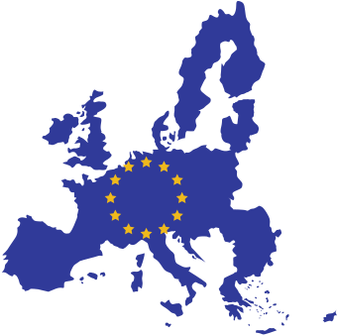

What does it do?
It reads the Commission's proposals. It amends it if it disagrees with it. It has to discuss everything with the Council of the European Union because only texts that are agreed by the Parliament and the Council become law and therefore reality.
It also keeps the Commission in check and can vote a motion of censure.
They represent the European citizens.
Who's in charge?
All 705 MEPs.
They elect a President every 2 and a half year, renewable for another 2 and a half years.

Slide 9
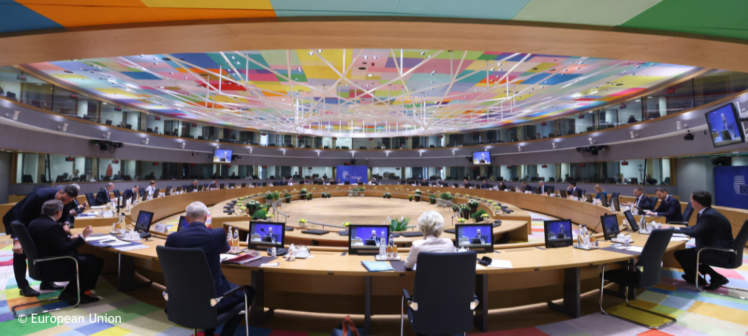
The Council of the European Union
When was it created?
In 1958 with the Treaty of Rome.
Who's in it?
The Council of the EU is composed of a Minister from each Member State.
Which Minister? Well, it depends what topic is under discussion. If it is the environment, then the 27 Ministers for the Environment meet. If it is the economy, the 27 Minister for Finance meet, etc.

Slide 10


What does it do?
It reads the Commission's proposals, like the European Parliament. It amends it if it disagrees with it. It has to agree everything with the Parliament for the proposal to be passed and to become law.
Each Minister fights for their national interests.
Who's in charge?
Each Member State is in charge for 6 months. It's a rotating presidency. Ireland had it in 2013 and will have it again in July-December 2026.

Slide 11
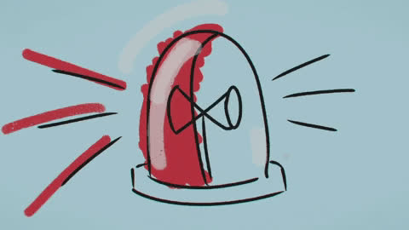

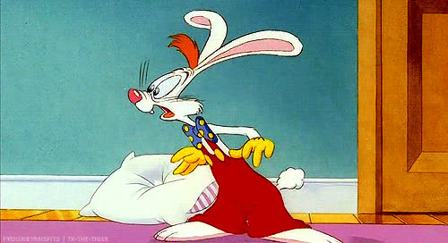
The European Council
Council of the EU
Yes, two institutions have very similar names but are different bodies. And you've also heard about the Council of Europe, which isn't even an EU institution

Slide 12
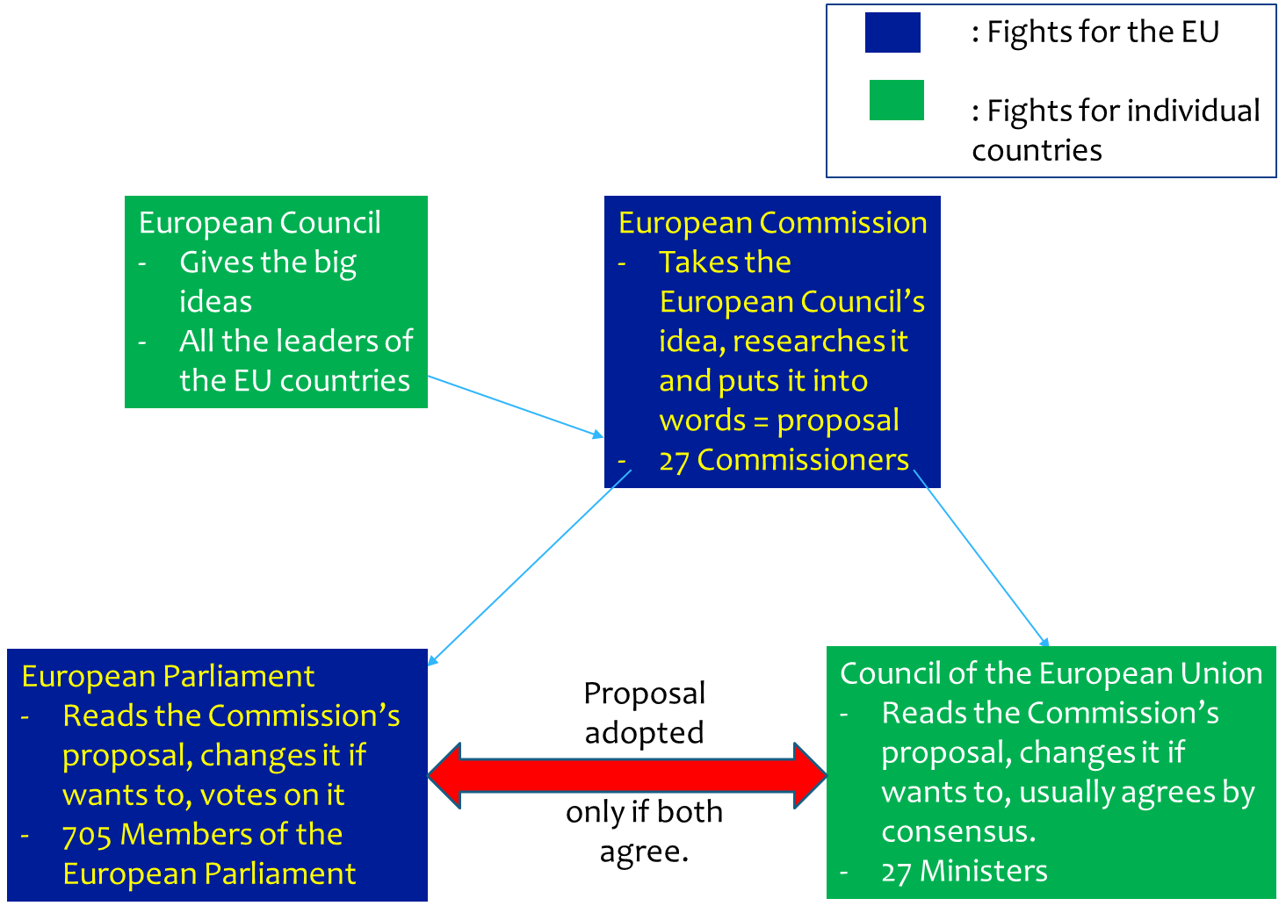
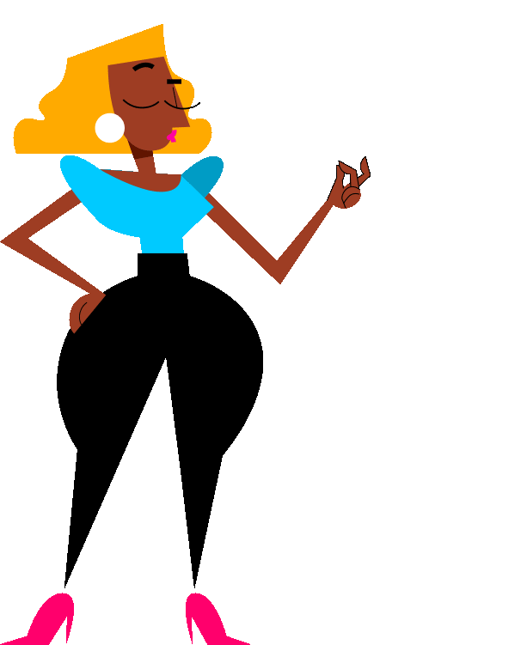
A summary...

Slide 13


And when the EU institutions and citizens all come together, it gives this

Slide 14
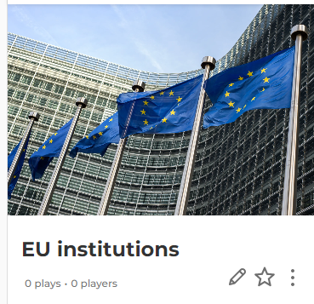



Let's play on the EU institutions in Kahoot

Slide 15






If you're curious, contact us, follow us
Hub in Active European Citizenship
@dab.the.eu
@dabtheeu
@HubEuropCitizen

