Slide 1


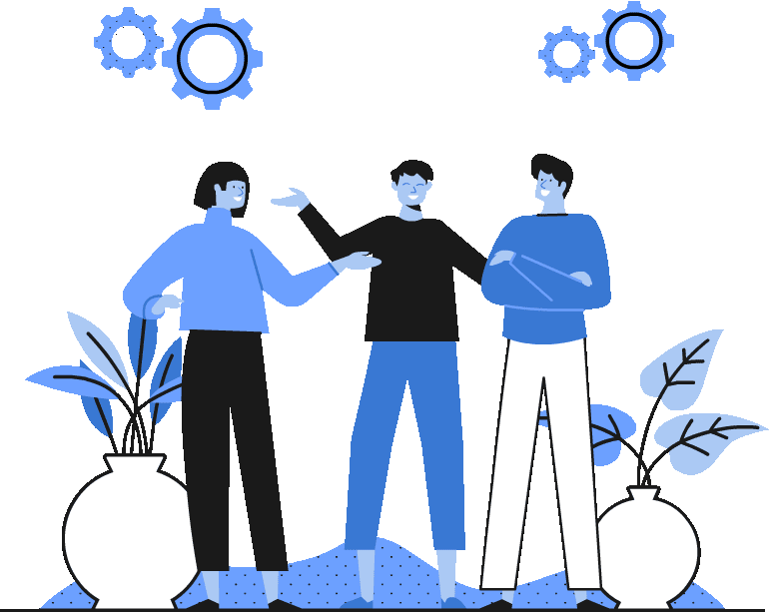


Topic 6
Sustainability and development in the EU
*New European Bauhaus
*Influence
CSPE - Strand 2 - LO 2.2, 2.4, 2.10 - 30 minutes

Slide 2


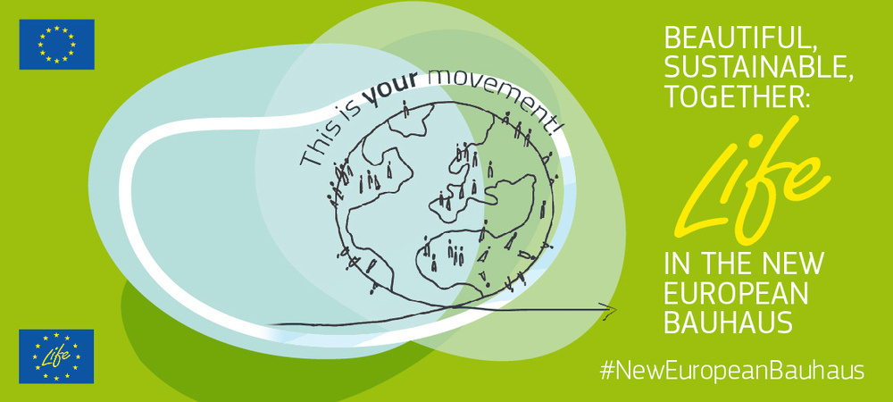

The New European Bauhaus
The New European Bauhaus initiative connects the European Green Deal to our daily lives and living spaces.
HOW DOES IT DO IT?
It takes ideas from the world of science and technology, art and culture.
It makes the most of our green and digital challenges to transform our lives for the better.
Finally, it gets people involved in co-creating solutions.
Click here to watch a one minute video explaining the New European Bauhaus.

Slide 3
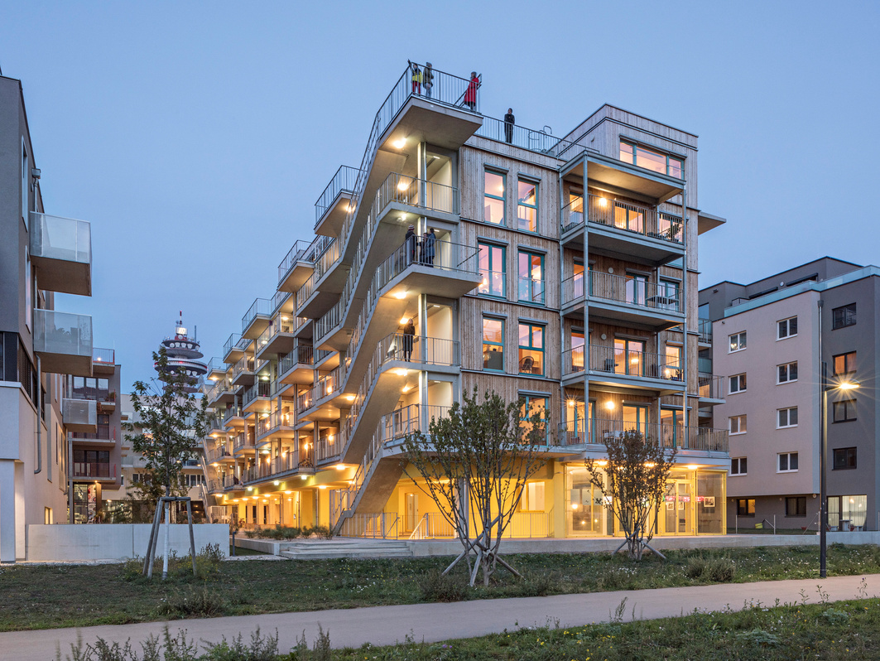

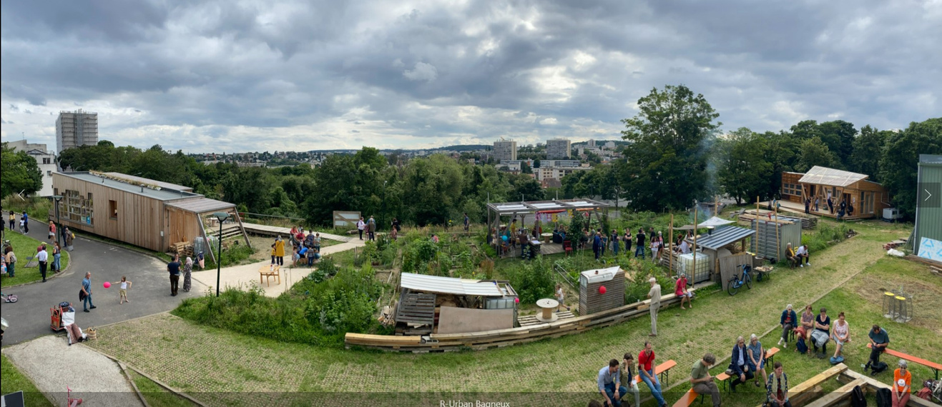
The values of the New European Bauhaus
  sustainability, from climate goals, to circularity, zero pollution, and biodiversity
  aesthetics, quality of experience and style, beyond functionality
  inclusion, from valuing diversity, to securing accessibility and affordability
What does it look like in practice?
Watch the videos of winning New European Bauhaus 2022 projects, click here.

Slide 4


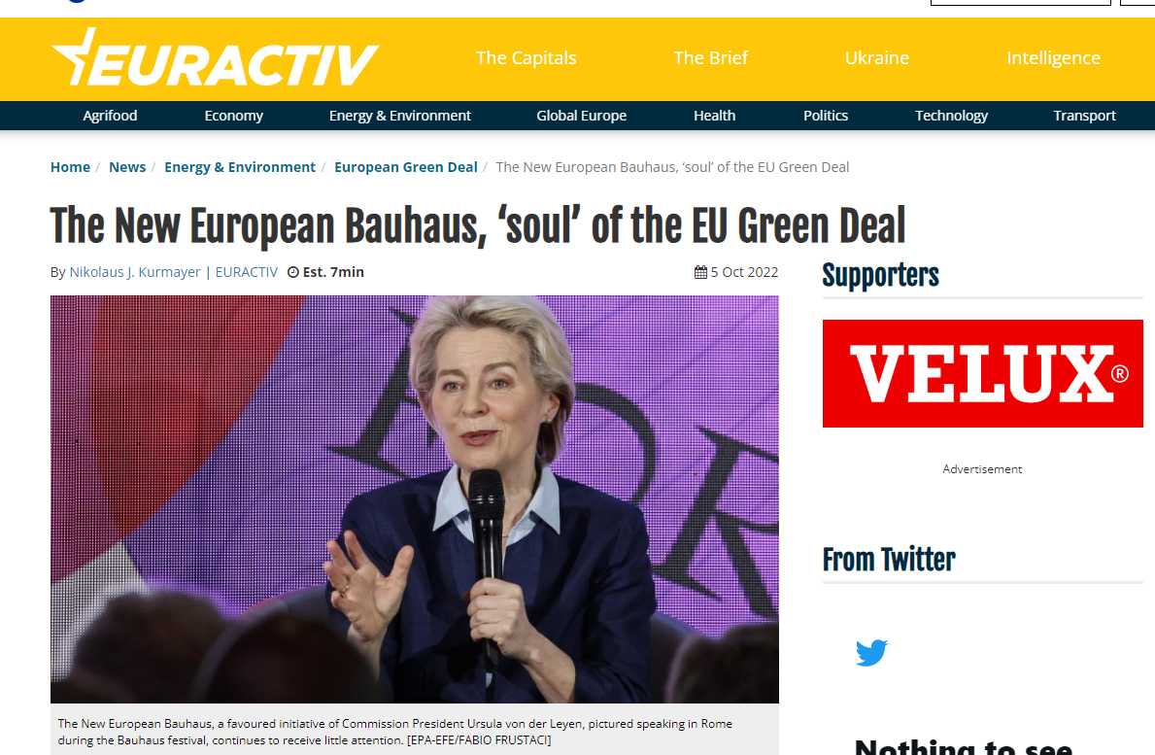
Activity
Read this article and answer the questions on the page distributed by your teacher

Slide 5

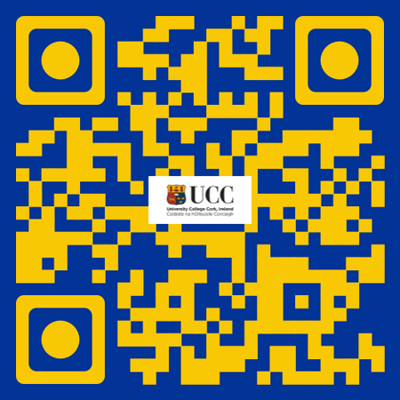




If you're curious, contact us, follow us
Hub in Active European Citizenship
@dab.the.eu
@dabtheeu
@HubEuropCitizen

