Slide 1


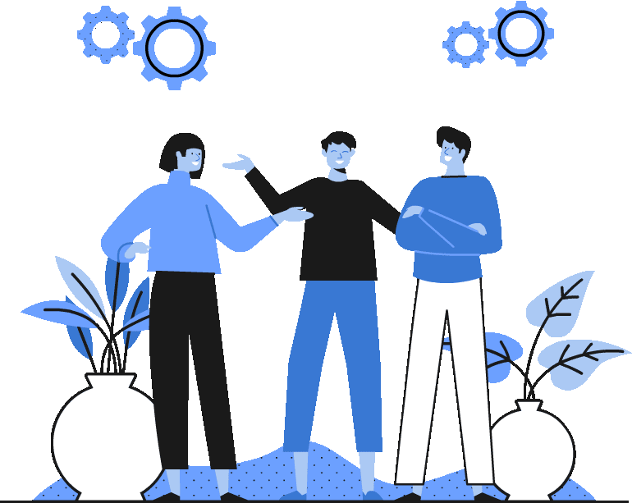


Topic 3
Interdependence and
European citizenship
*What it is
*What it involves
*Interdependence
*Sustainability of the EU
CSPE - Strand 2 - LO 2.1 - 25 minutes

Slide 2
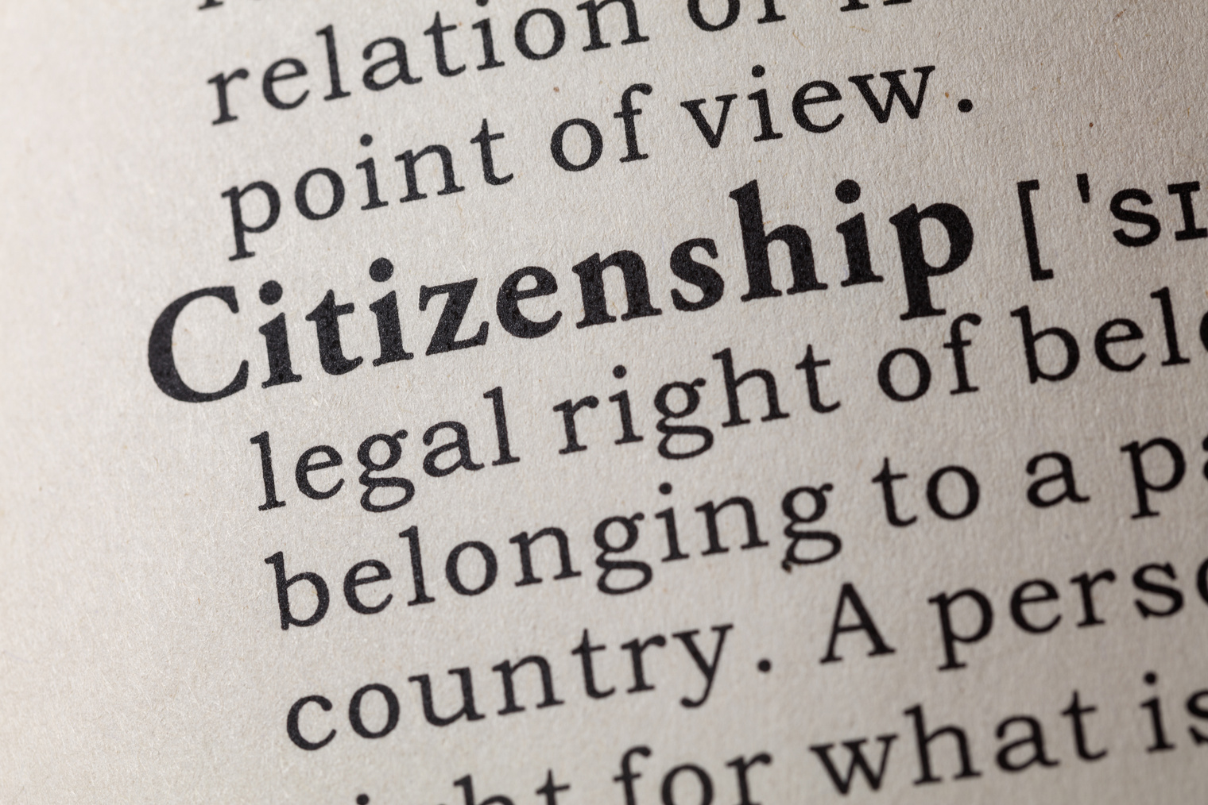

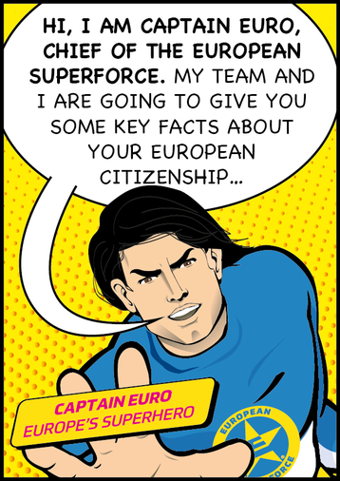

What's citizenship?
Citizenship is a relationship between you and the state, e.g. Irish state, in which you are both bound together by reciprocal rights and duties.
You owe to the state to comply with its rules and the state owes you to protect you.
A global citizen understands the wider world and their place in it.

Slide 3



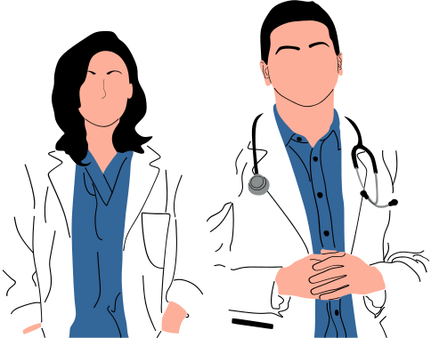
European citizenship: what does it give me?
In the case of European citizenship, you and your country need to respect the rules and values of the club.
In exchange, the EU will protect your rights to travel freely, to study and work in any EU country, to get public healthcare, etc

Slide 4
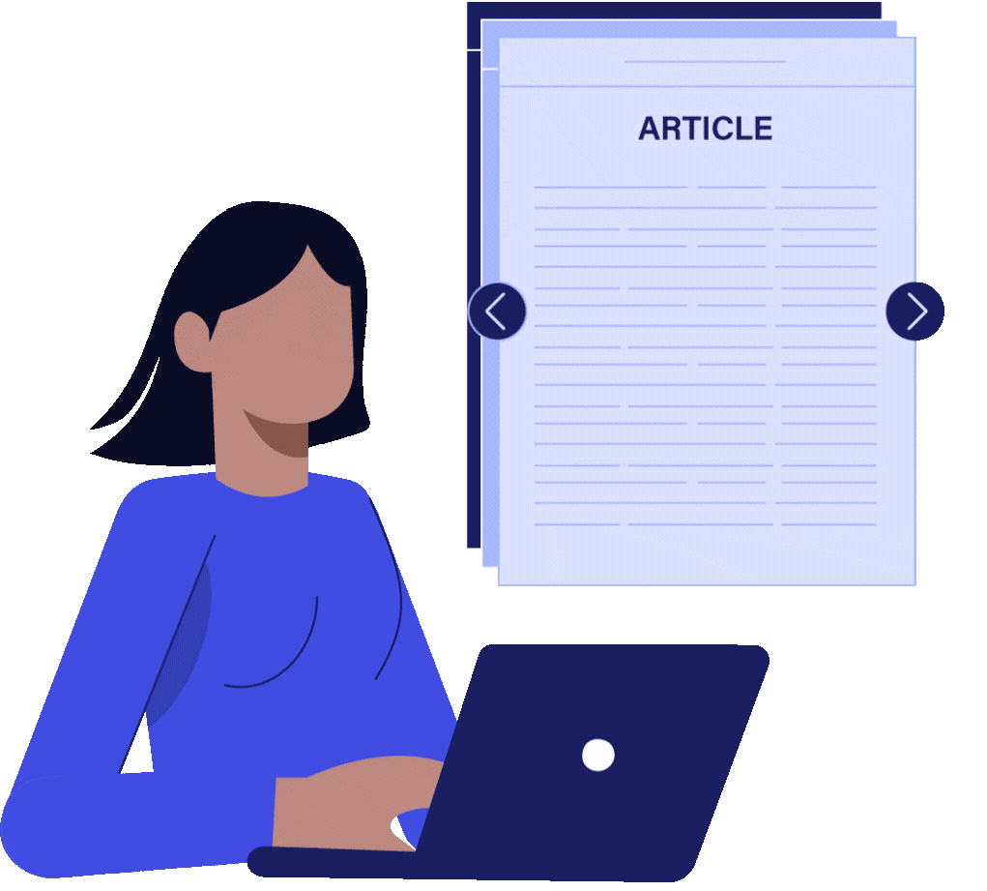
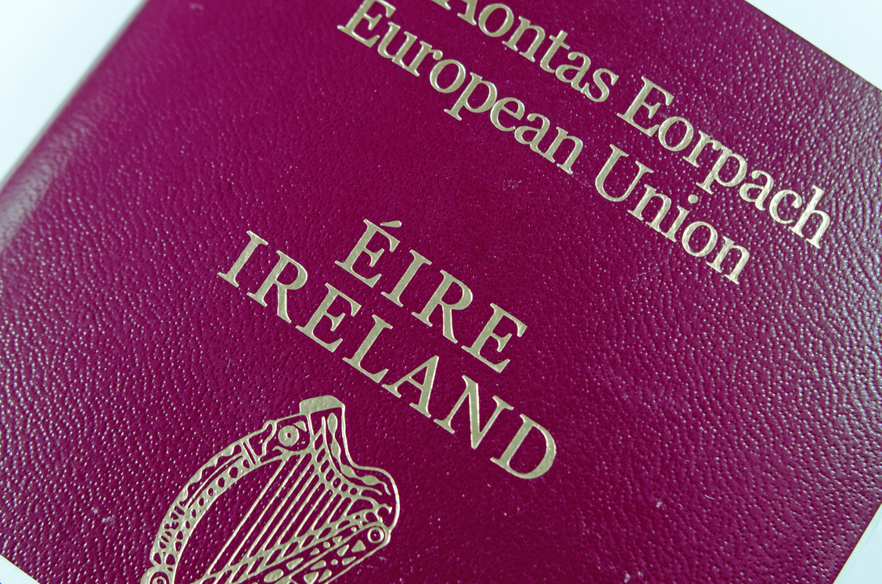

What does European citizenship mean for you?
The Treaty on the Functioning of the European Union signed in 1992 in Maastricht gives EU citizens a number of rights
  non-discrimination on the basis of nationality. e.g. an Irish plumber cannot be refused employment in another EU country if he meets the requirements
  Move and live wherever you want in the EU. No need for visas.
  Vote for and stand as a candidate in the European and local elections in any EU country
  Start or support a European Citizens' Initiative
Your European citizenship joins your Irish citizenship. It doesn't replace it -
look at the cover of your passport!

Slide 5

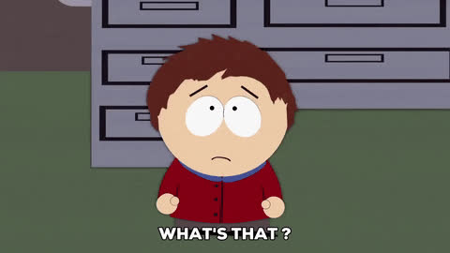

Other rights given by European citizenship
  Study anywhere in the EU more cheaply than non-EU citizens. That's Erasmus for a year or a semester!
Erasmus is an exchange programme for university students, apprentices, teachers, and lecturers.
  Set up and grow your start-up or small and medium enterprise anywhere. The EU has funding to support it.
and more...
These rights can happen because of EU countries' interdependence.

Slide 6


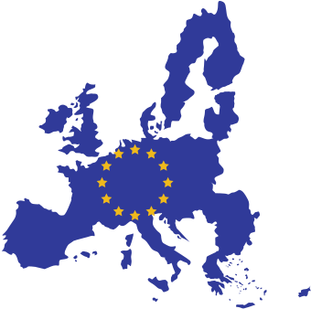
From dependence to interdependence - Ireland in the EU
Dependence is when you rely on something/someone
Ireland moved from being dependent on its economic links with the UK before 1973 to
interdependence in the EU where it is part of a club whose countries rely on each other for upholding rules, standards, values, citizenship rights, etc.

Slide 7


Reflection
Thinking about your Irish and European citizenships, answer the following questions:
  When was the last time you were in another EU country than Ireland?
  Which one was it?
  Did you need a visa to get in?
  Was there a specific queue for European passports?
  Did it use the Euro as a currency?
  What benefits from your European citizenship do you think you might enjoy the most. Explain:
Studying abroad Working abroad Interrailing
Setting up a company abroad Standing up for election in another country?

Slide 8






If you're curious, contact us, follow us
Hub in Active European Citizenship
@dab.the.eu
@dabtheeu
@HubEuropCitizen

